Slide 1
Theory and Practice of Security & Privacy Part 5 Security of Data
arnaud.nauwynck@gmail.com

Slide 2
Notice: Security of System <--> Security of Data
if System is unsecure => then Data on it is unsecure
general security concerns on System ... see previous course : Part 4
specific concerns on "Security of Data" ... this course : Part 5

Slide 4
Access to PC Hard Disk => can read/write 010010101
Reminder
Rule # 1 = Encrypt Disks
encryption key (in BIOS ? should be secured)

Slide 5
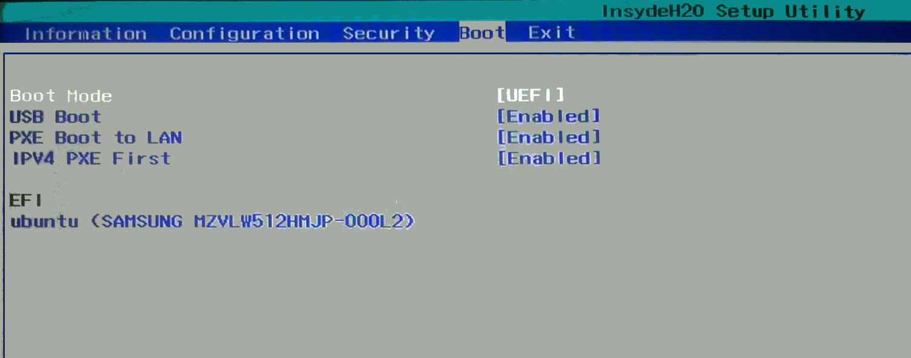
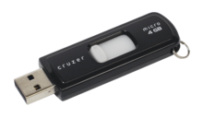
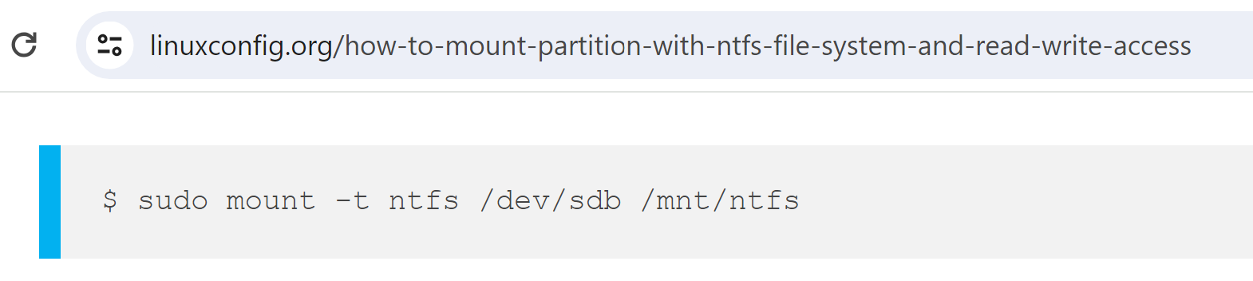
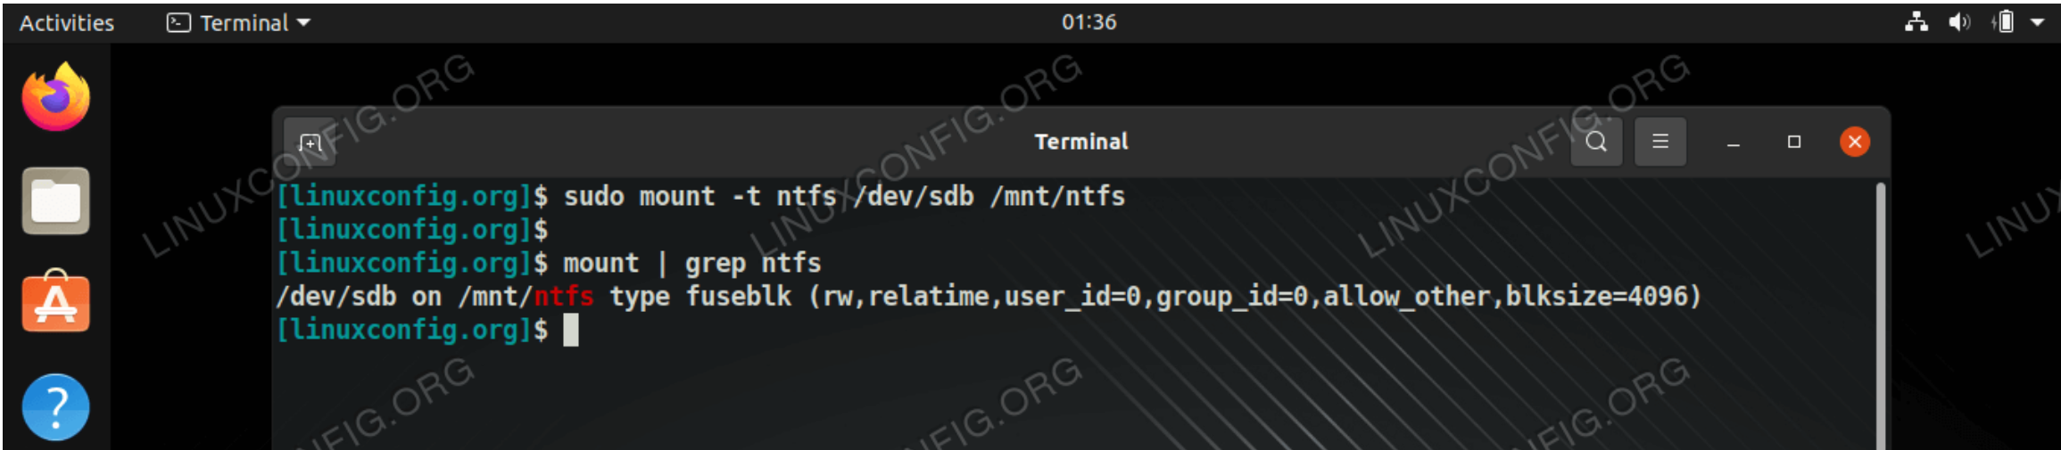
Un-Encrypted Disk? can we (do you need to) Boot ?
Reminder

Slide 6
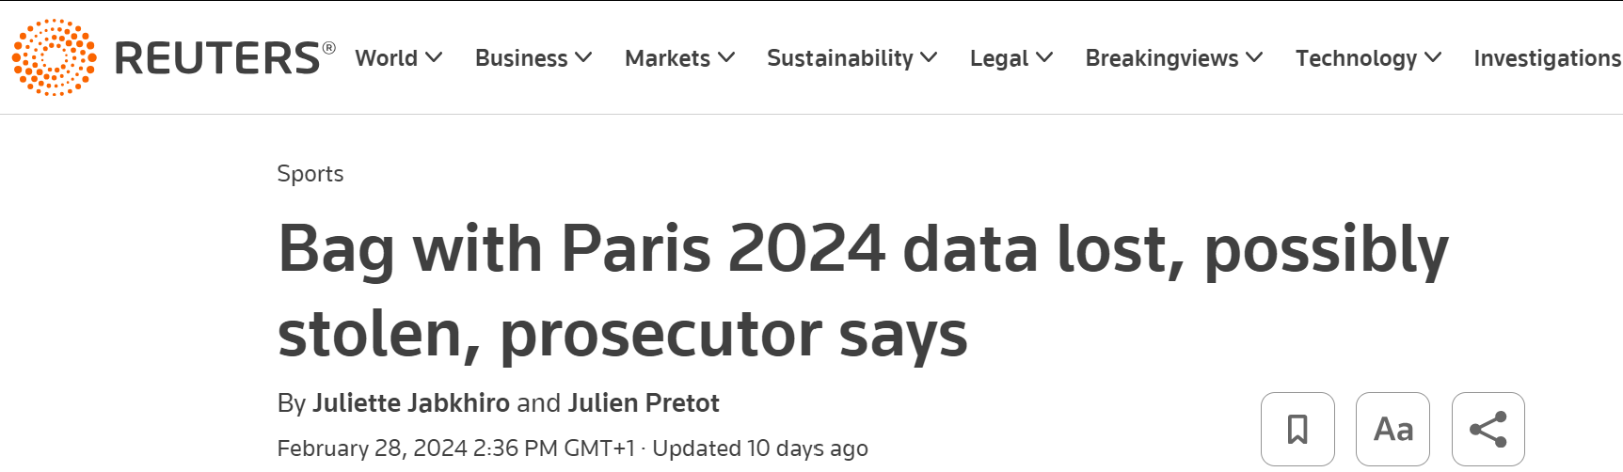
Un-encrypted Disk : risk for Data stolen Anecdote as of 2024-02
"if" stolen Pc (Disk) was encrypted => "no" issue (only "lost")
but was it ?

Slide 7
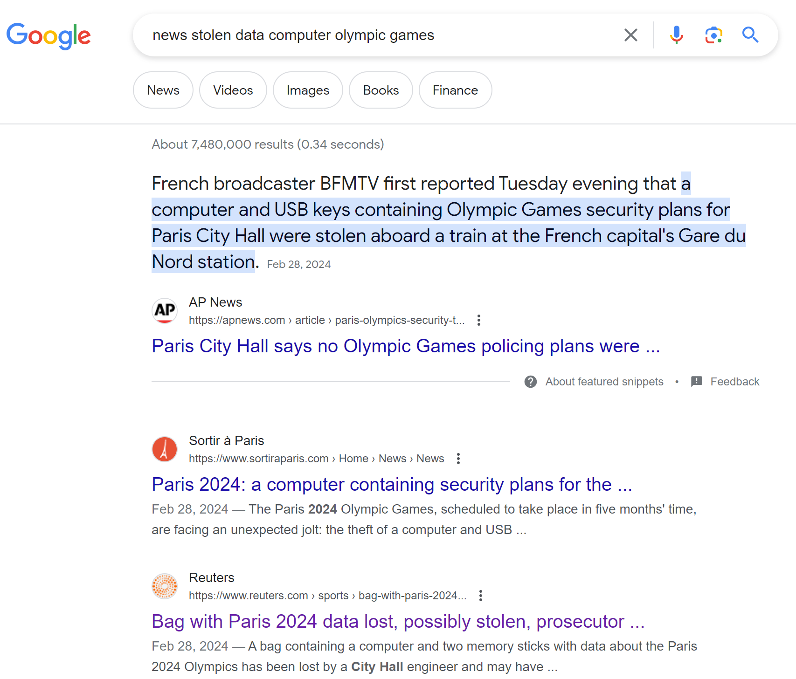
7 millions search results

Slide 8
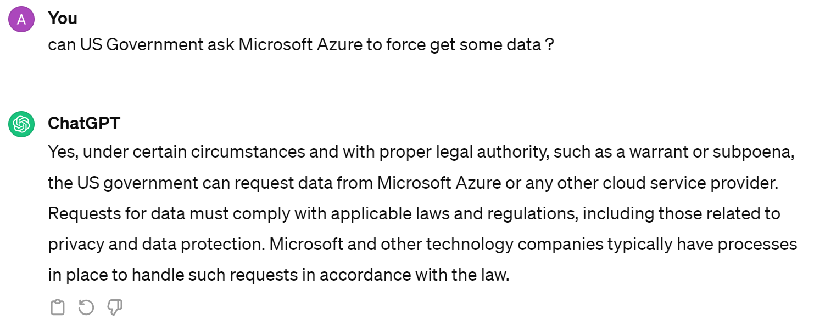
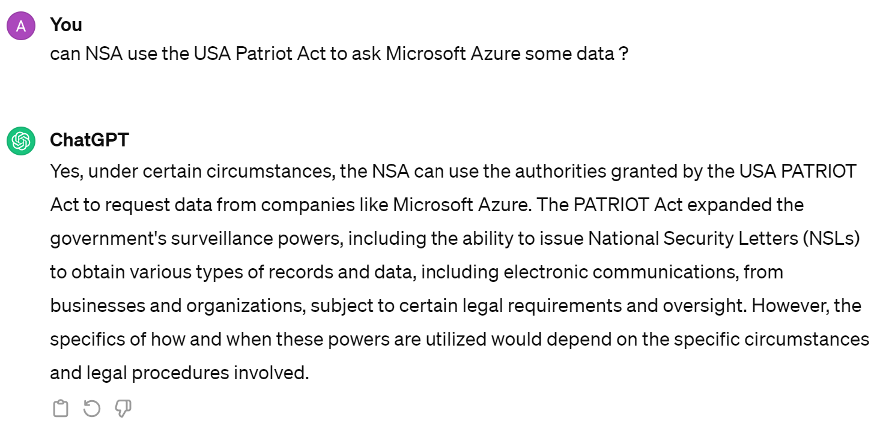
Security of Data on Public Cloud Provider ? Privacy ?
Security != Privacy

Slide 9
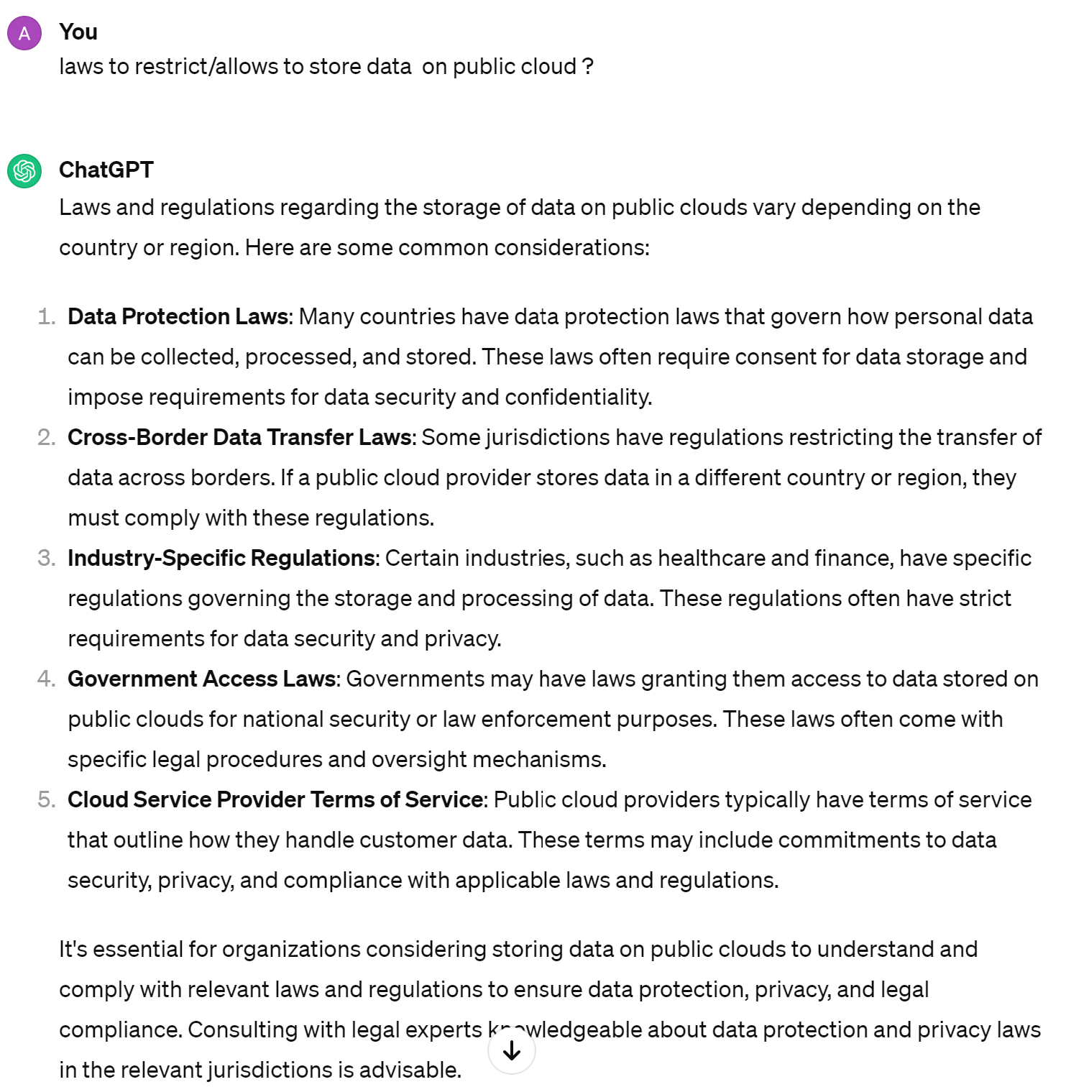
Lows to restrict/allow Data on Public Cloud

Slide 10
Data Across Border
How to practically check ?
Choose your "Region"
Trust
Example: Bank in Europe on Azure
=> choose Azure West-Europe, or Azure North Europe, ..
How to be sure "NO data" is sent to US ?

Slide 11
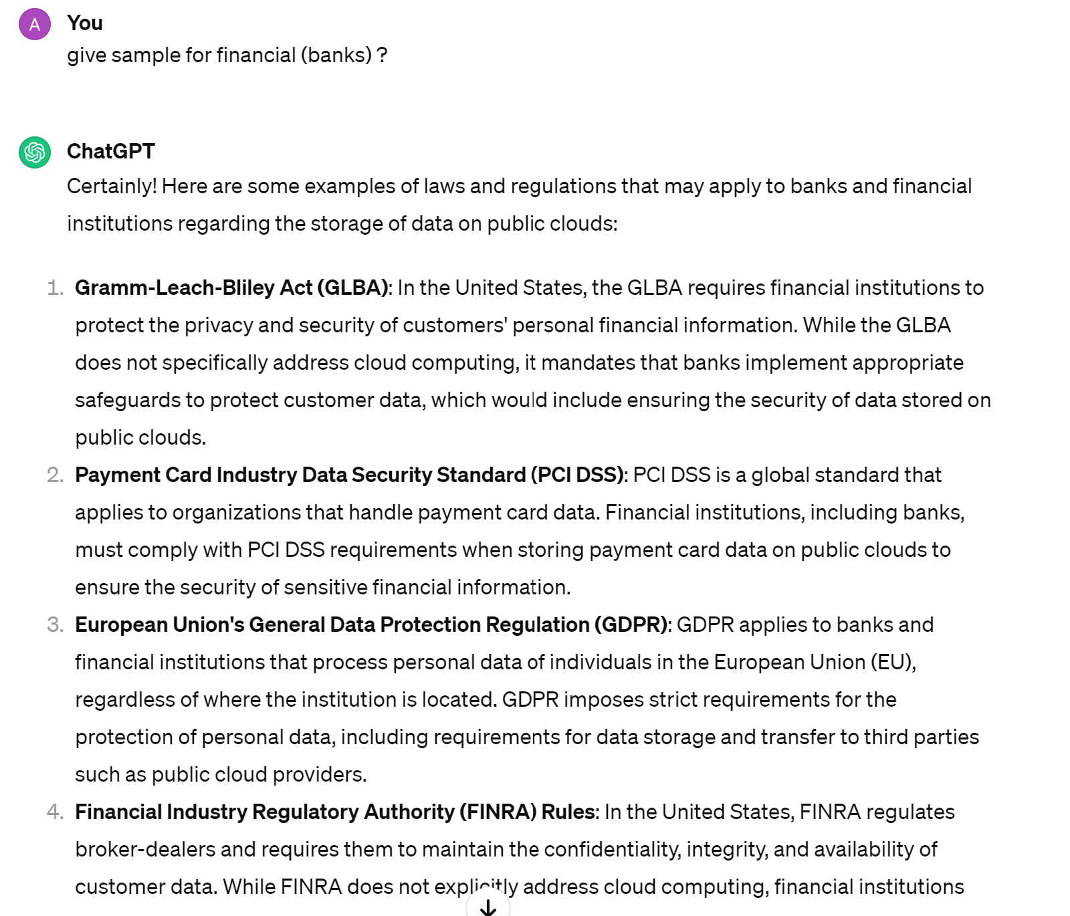
Laws ..

Slide 12
Fears, Customers, .. Data Classification C0,C1,C2 Eligibility to Cloud
Most companies classify their data with classification levels
example:
C0 = public data (ex: official CAC40 closing price yesterday)
C1 = internal data (ex: organigram of employees
C2 = private data (ex: trade with client, password)
C3 = ultra confidential data
example of program to cloud:
fears => up to C1
trust => C2

Slide 13
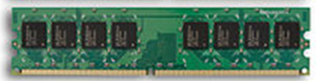

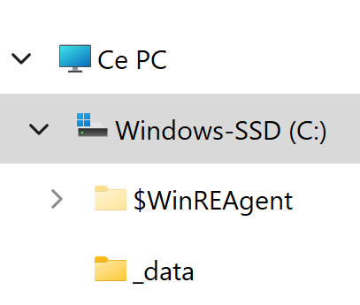

Encrypt Files vs Encrypt FileSystem
.exe
.exe
tmp copy
used by App
clear text
clear text
clear text
clear text
System call "write()"
System call "read()"
explicit encrypt
$ openssl enc file.txt ..
explicit decrypt
$ openssl enc file.txt ..
write
=> on the fly encrypt
read
=> on the fly decrypt
SALT_x$ %1!4xA6
9érP5°w
explicit copy
<opaque>
01010101

Slide 14
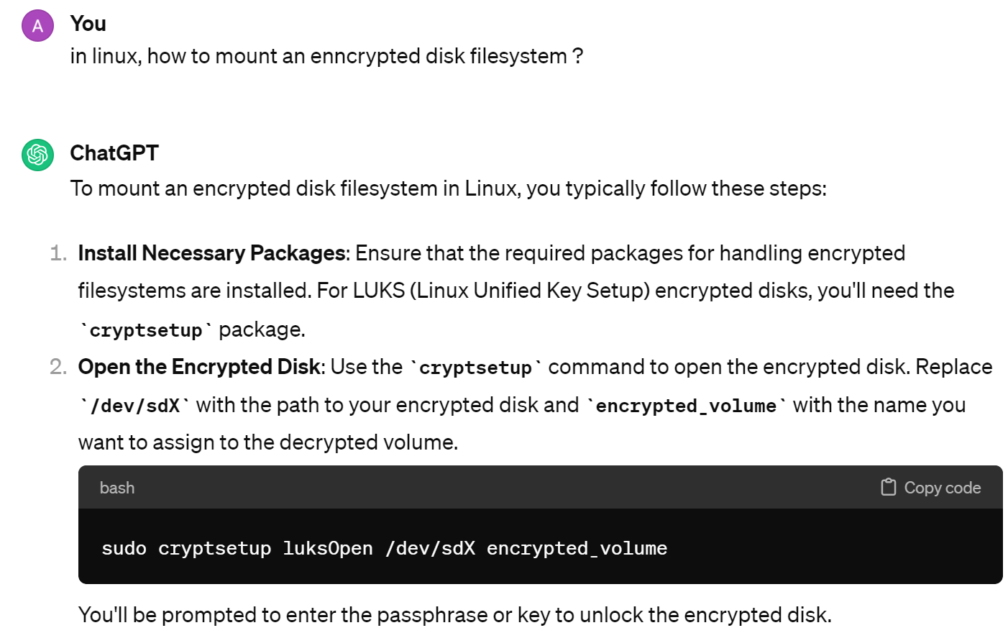
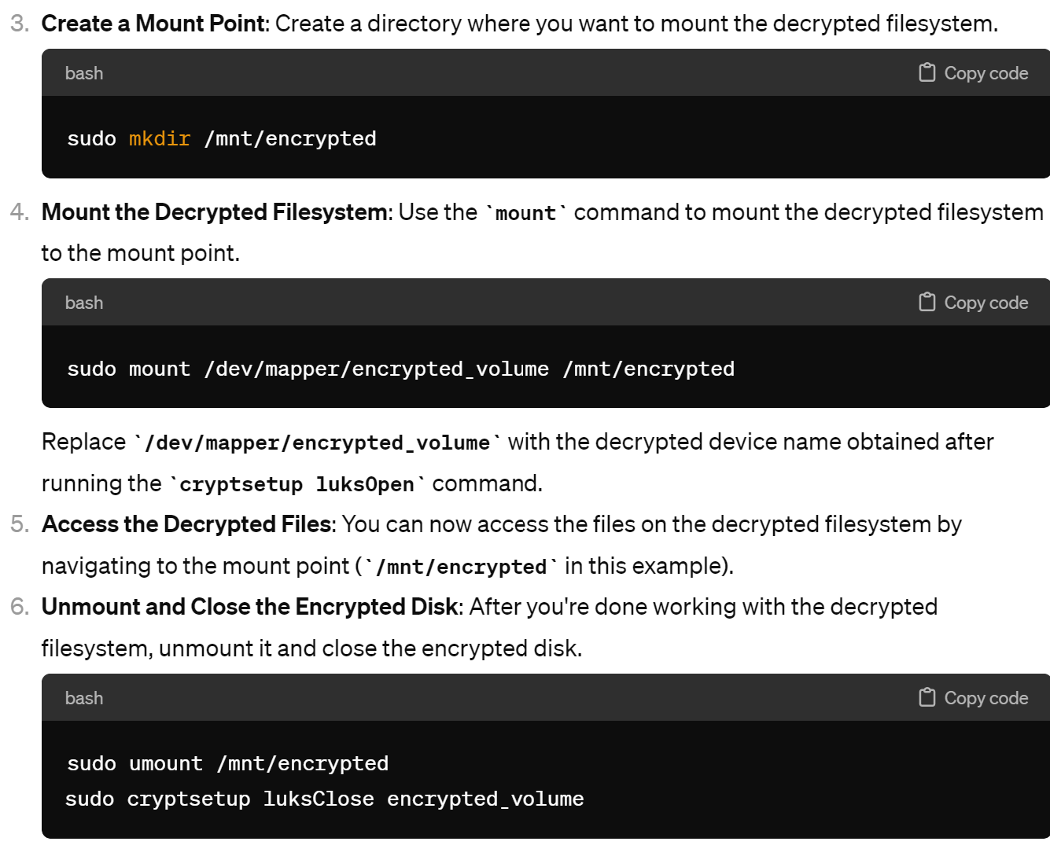
Mounting Encrypted FileSystem ex on Linux : LUKS (Linux Unified Key Setup)

Slide 15
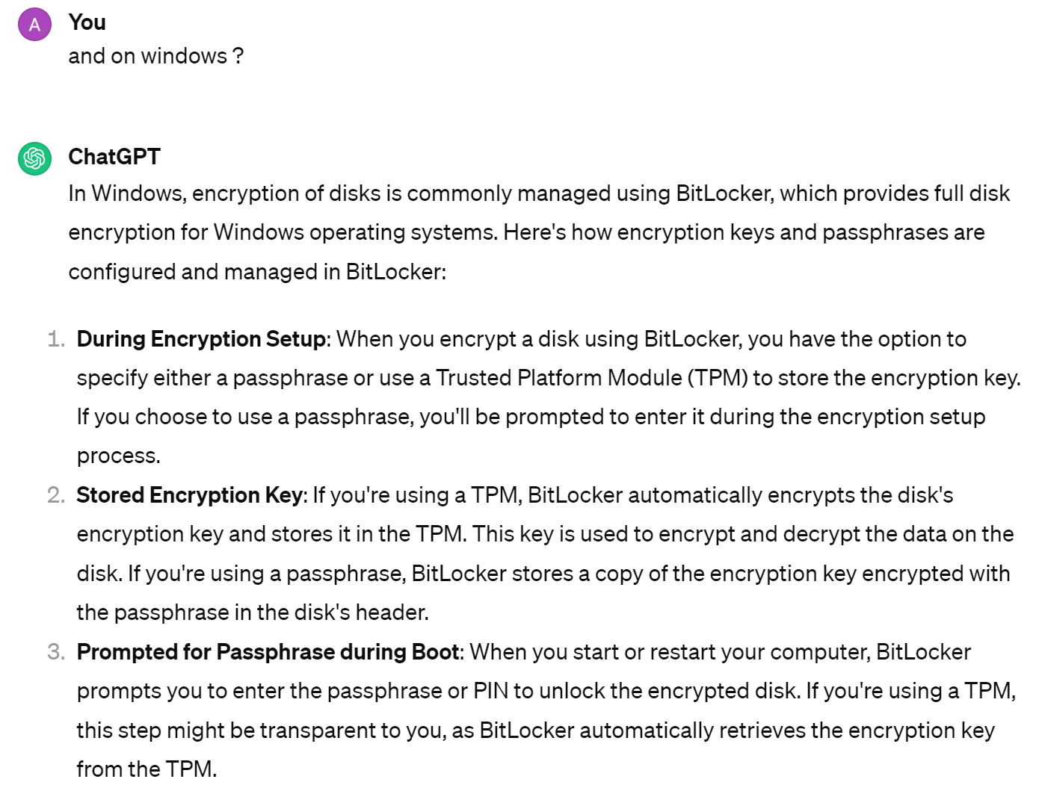
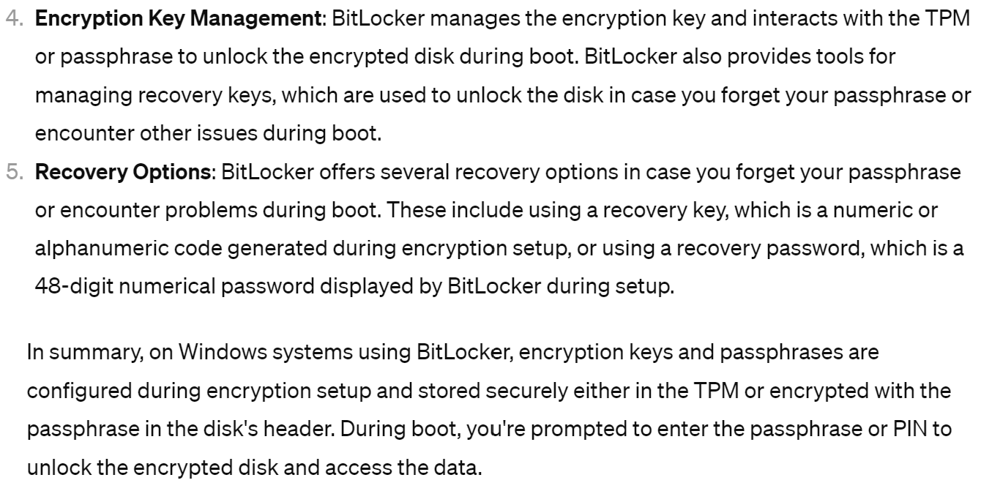
on Windows

Slide 16
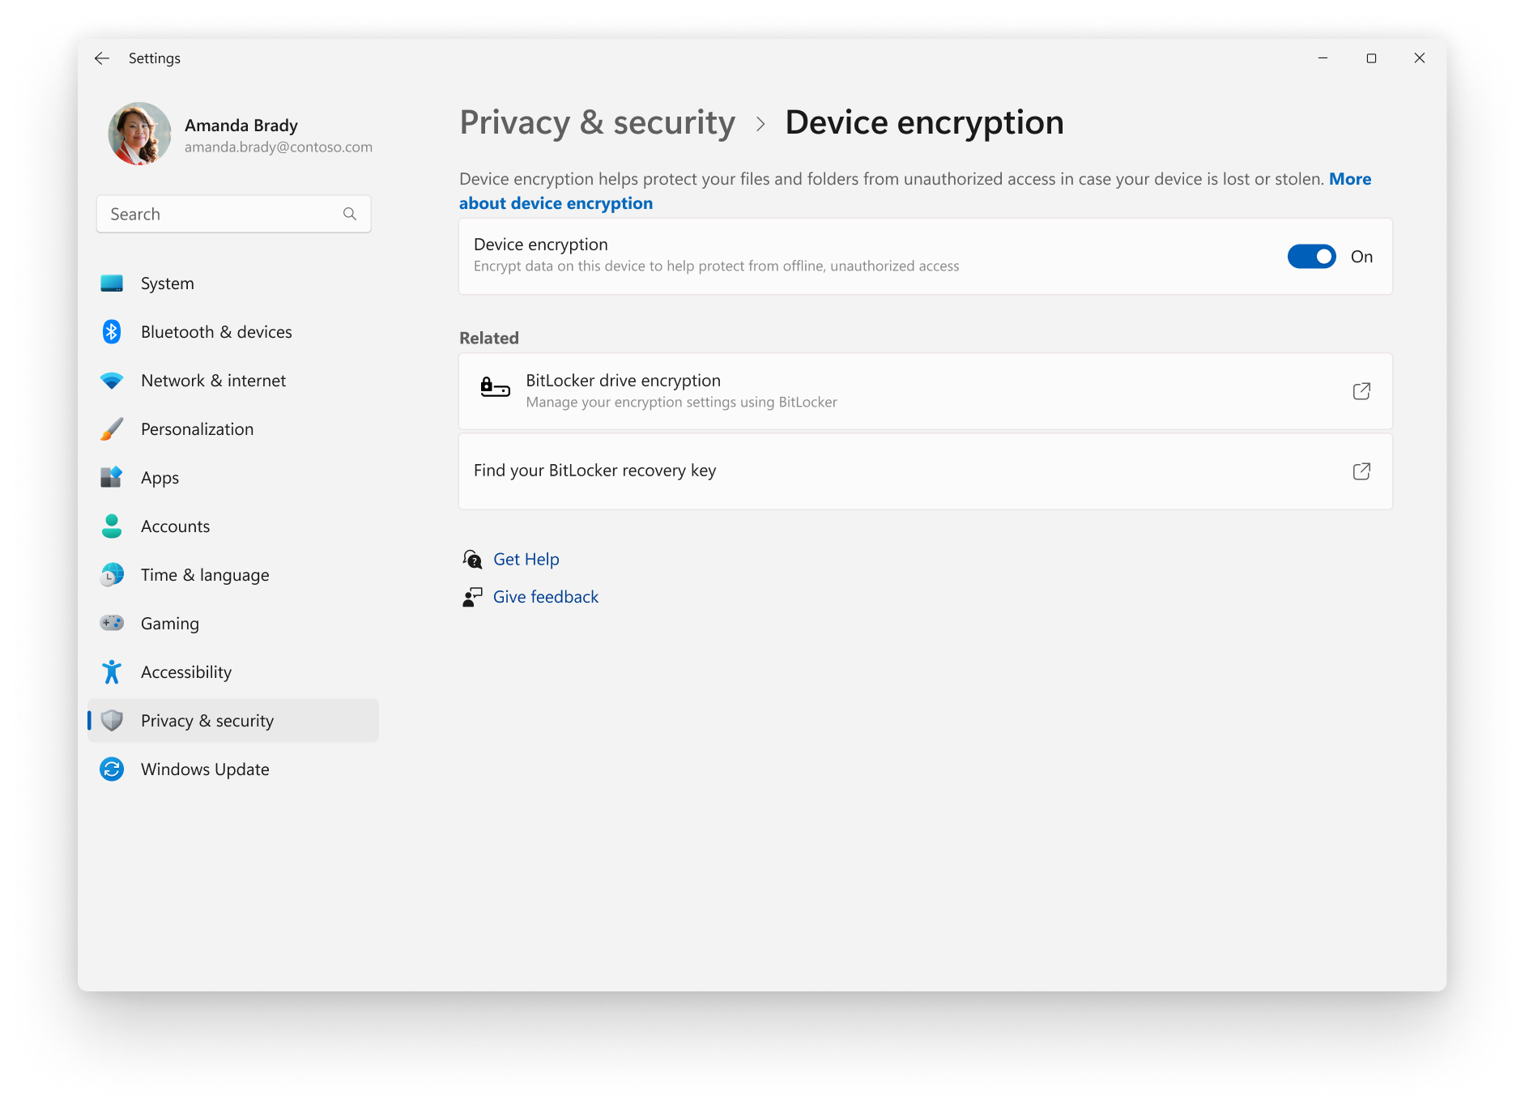
Windows BitLocker

Slide 17
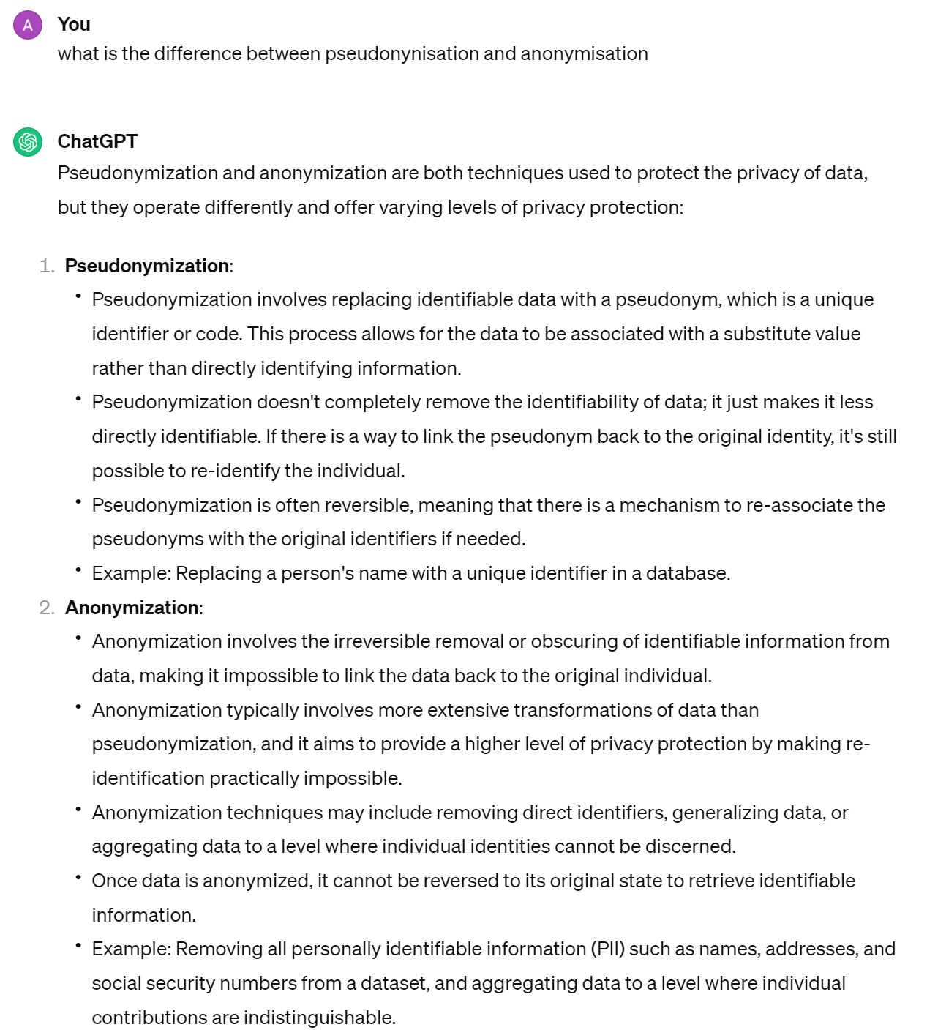
Pseudonimisation / Anonymisation

Slide 18
Data Access Authorization

Slide 19
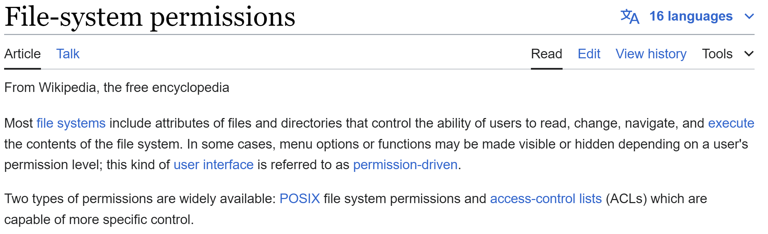
File System Permission POSIX (umask) & ACL (Access-Control List)

Slide 20
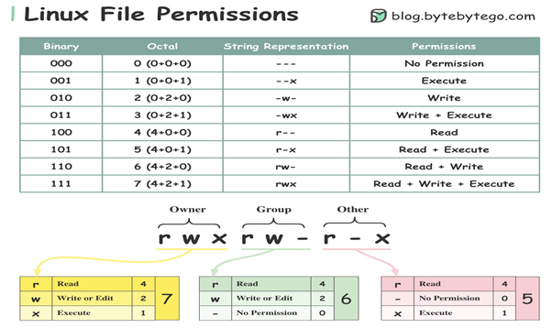
$ chmod go-rwx

Slide 22
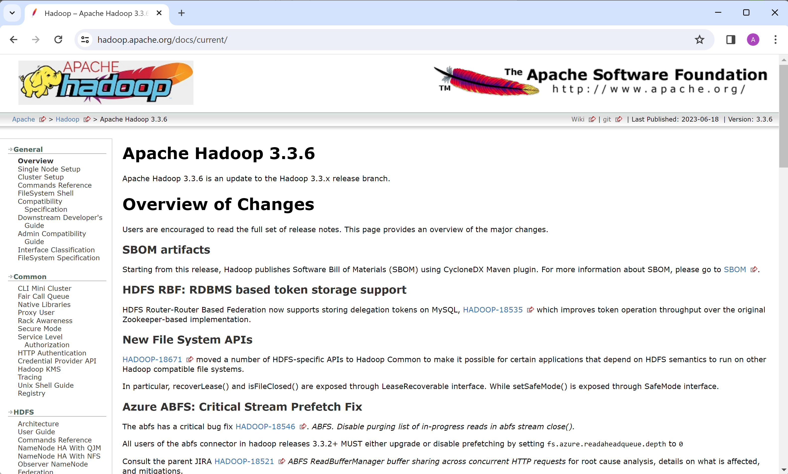
https://hadoop.apache.org

Slide 23
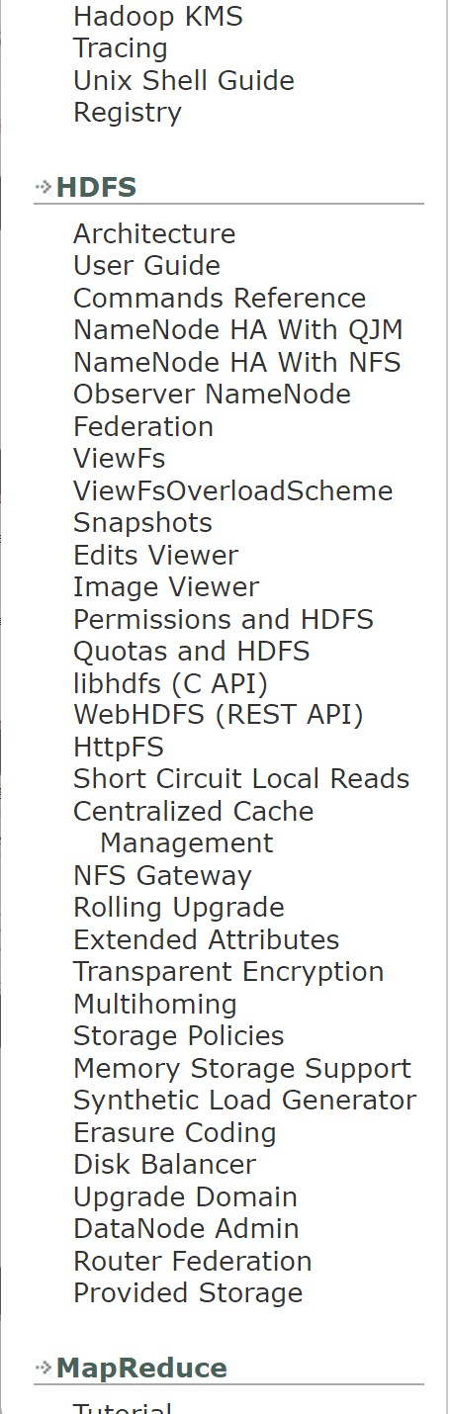
HDFS (Hadoop Distributed File System)
Notice Hadoop != HDFS
HDFS = sub-project of Hadoop (inpired for Google BigTable - File)
Hadoop File System = Java API (abstract class)

Slide 24
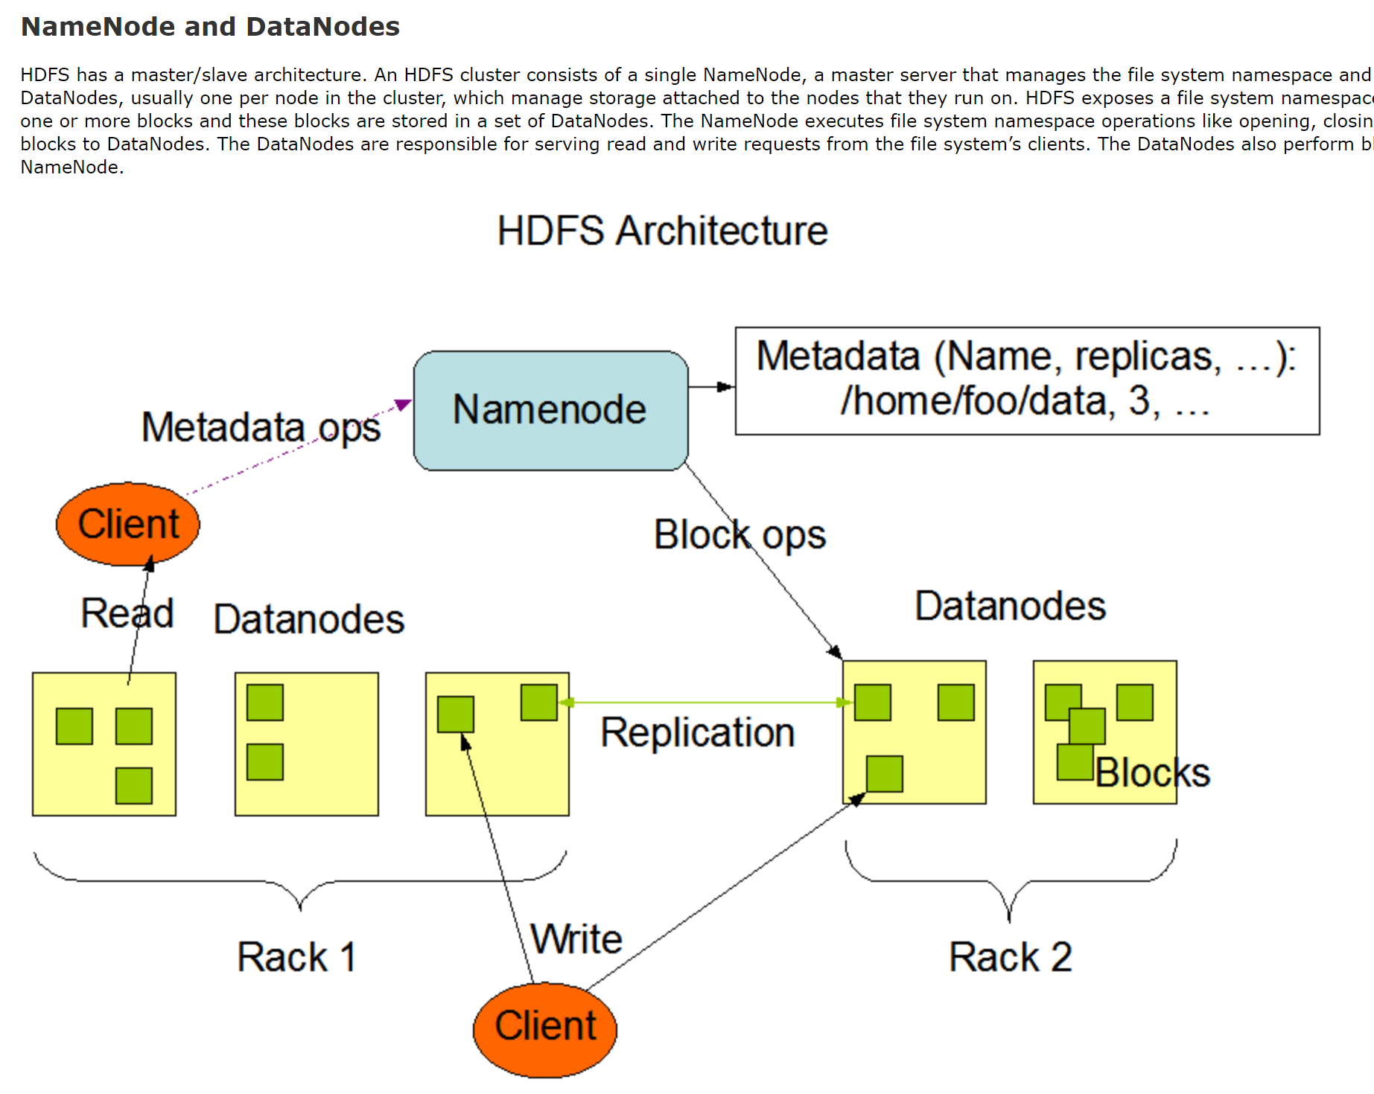
HDFS Architecture

Slide 25
HDFS Scalability (DataNodes)
There can be >= Thousands of DataNodes
But always 2 NameNodes ... The bottle-neck of HDFS Scalability
all Files have their metadata in-memory on the NameNode
(~ 4k per file .... 100 Million Files => require ~400 Go of RAM )

Slide 26
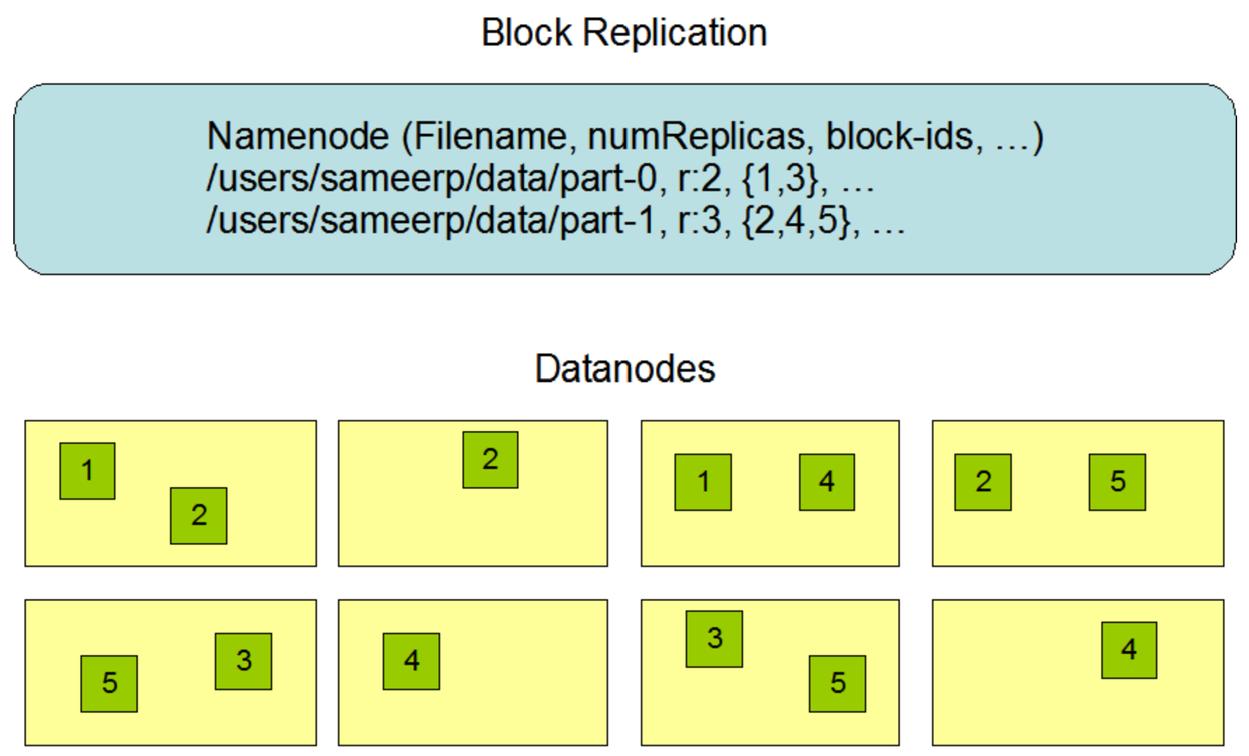
HDFS Block Replication (RF = ReplicationFactor = 3)

Slide 27
HDFS Client (Interfaces, Libraries, Shell)
simplest: Shell Commands $ hdfs dfs <<command>>
most used: Java API (DistributedFileSystem)
others:
mountable Fuse
C wrapper (libhdfs)
HTTP protocol
WebDAV protocol
NFSGateway

Slide 28
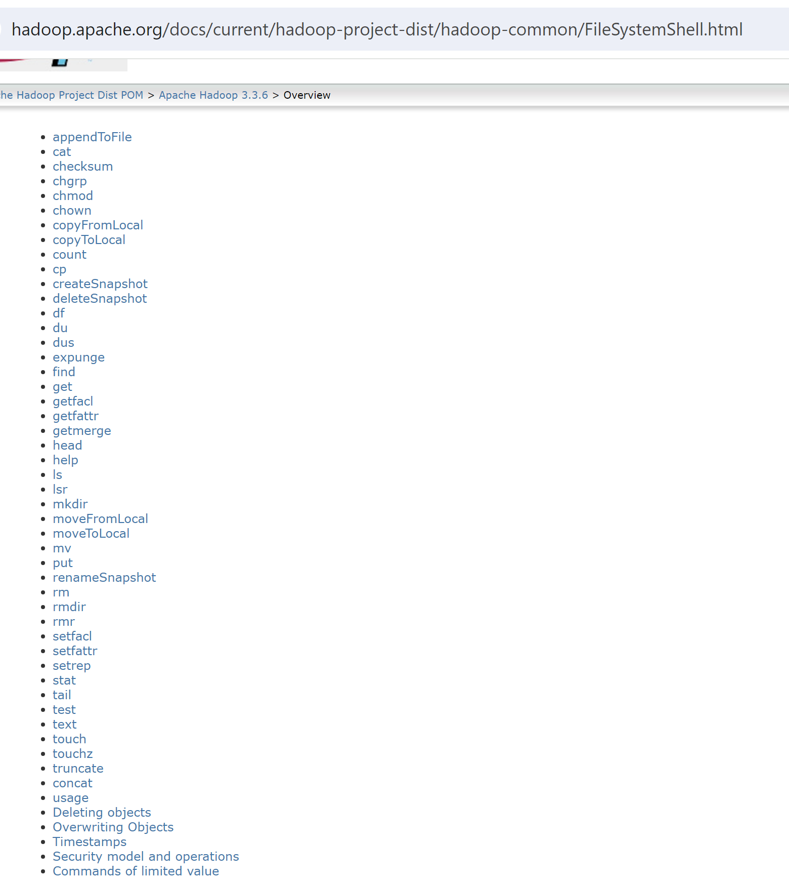
$ hdfs dfs -<<command>> ( = hadoop fs -<<command>>)

Slide 29
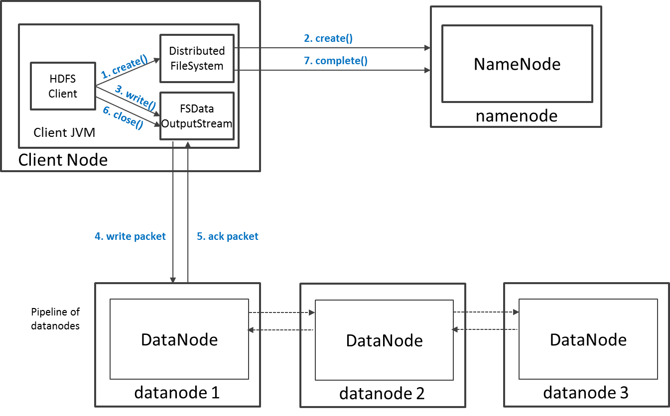
HDFS Write Operations

Slide 30
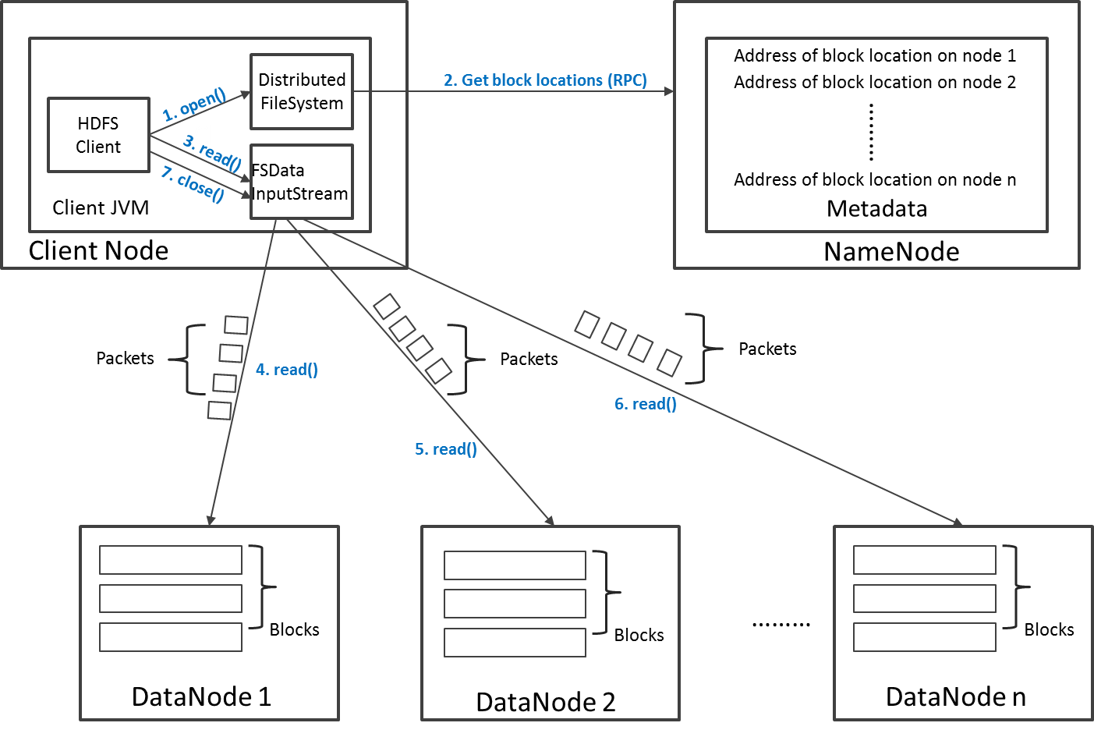
HDFS Read Operations

Slide 31
HDFS Authentication
2 possible modes :
Simple –using OS username (unsecure?) to determine hadoop identity
Kerberos – authentication using kerberos ticket
Set by hadoop.security.authentication=simple|kerberos

Slide 32
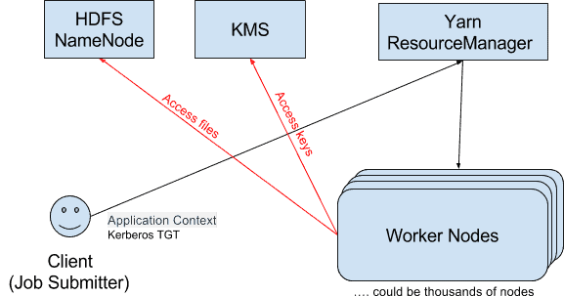

Slide 33
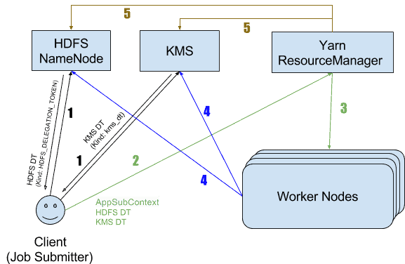
Hadoop Delegation Token

Slide 34
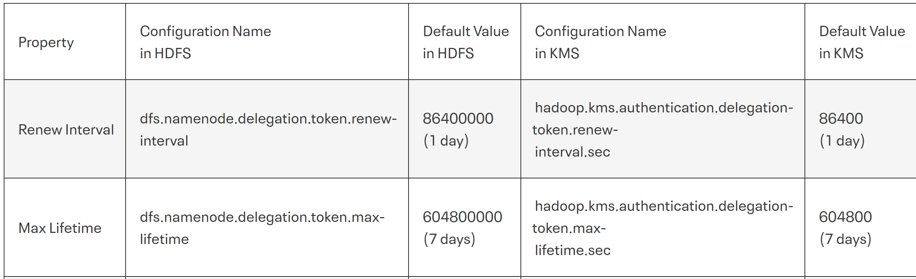
DelegationToken renew/max-lifetime

Slide 35
HDFS Authorizations : POSIX, ACL (checked by NameNode)
Standard POSIX Permissions for File and Directory
read (r), write (w), and execute (x) permissions
also has an owner, group and mode
enabled by default (dfs.permissions.enabled=true)
ACL = Access Control List
For more fine-grained permissions (!= owner user or group)
enabled by dfs.namenode.acls.enabled=true

Slide 36
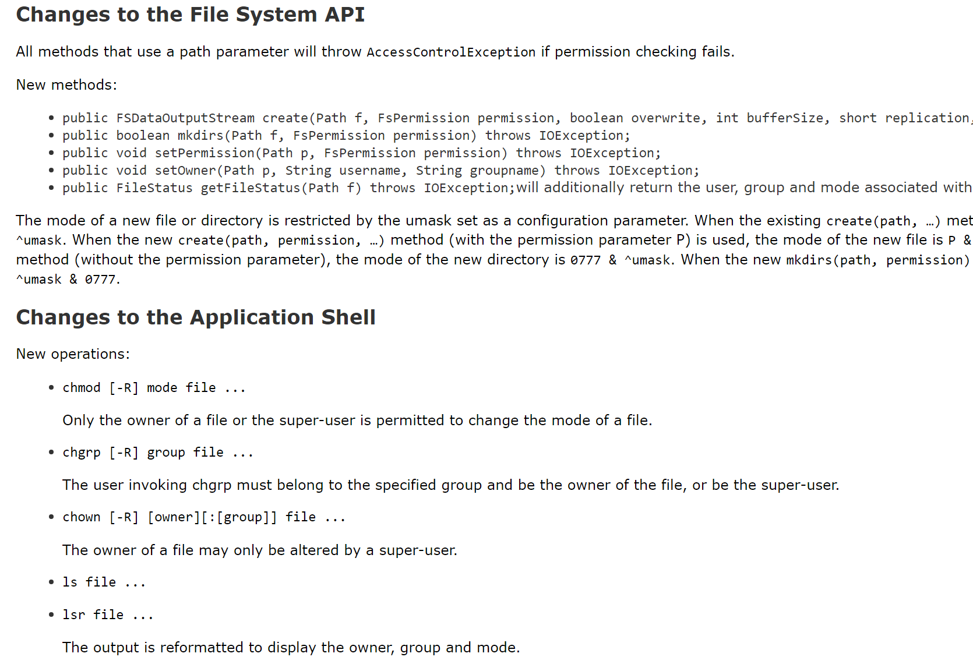
hdfs POSIX Permissions

Slide 37
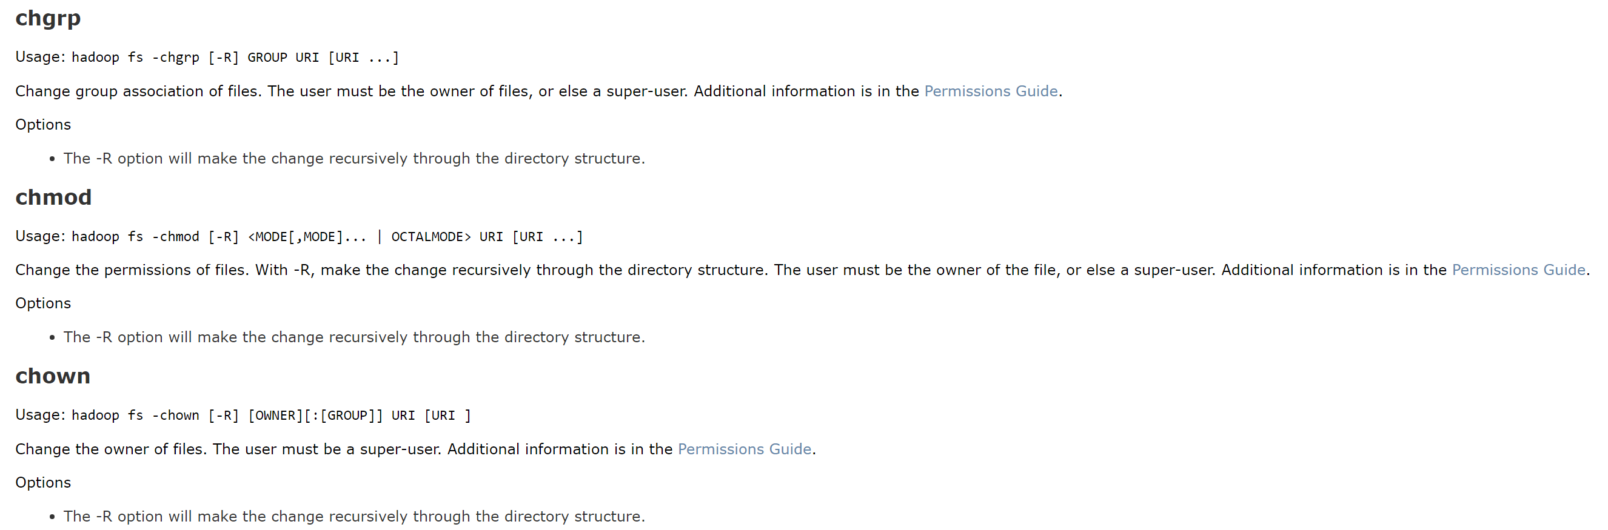
hdfs dfs -chgrp / hdfs dfs -chown hdfs dfs -chmod

Slide 38
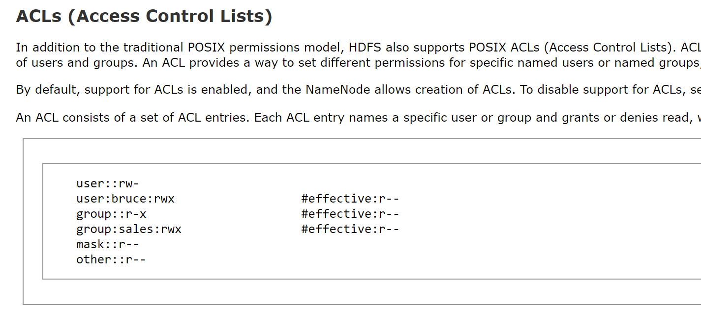
hdfs ACLs

Slide 39
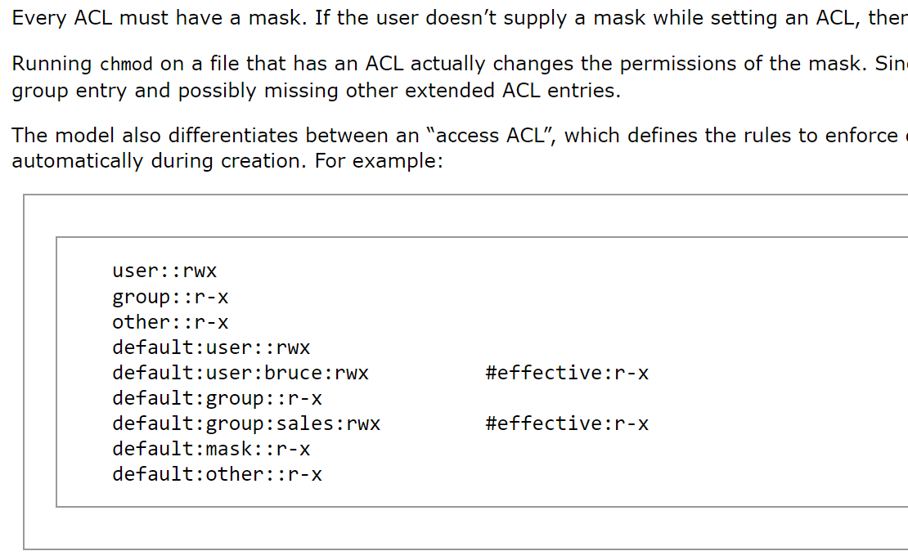
ACL (default) mask

Slide 40
Data on Microsoft Azure

Slide 41
Azure Datalake FileSystem Storage abfss://

Slide 42
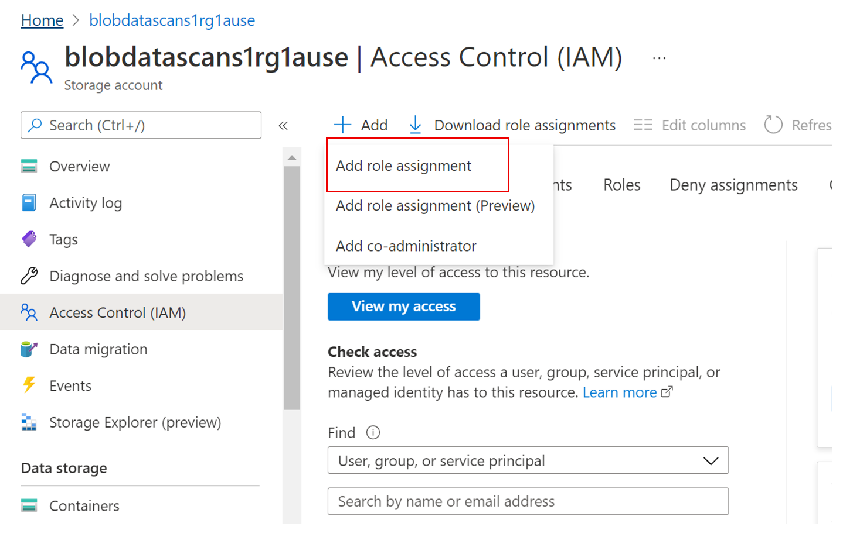
Azure Storage - Access Control (IAM)

Slide 43
Role: Storage Blob Data Owner

Slide 44
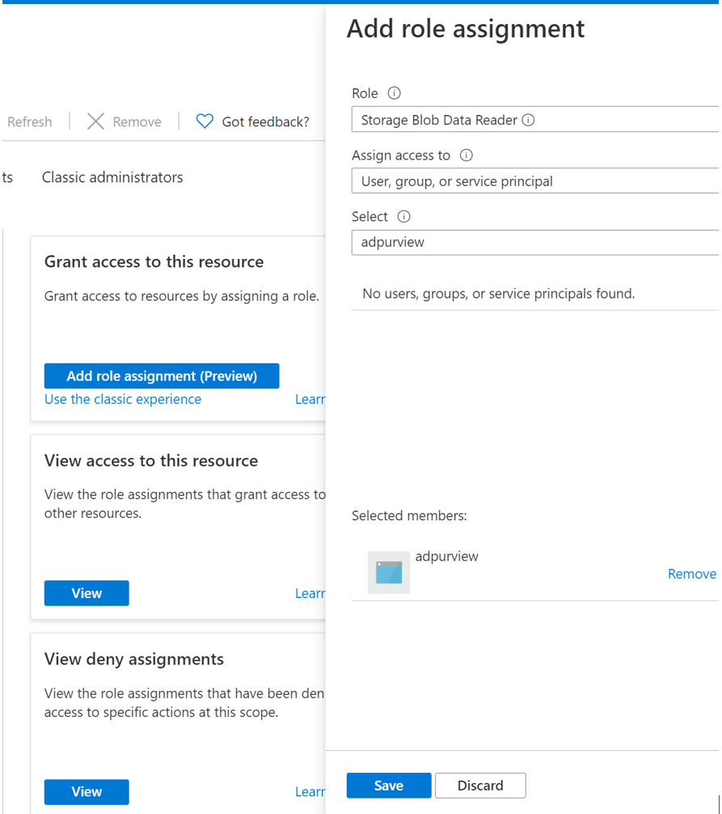
Role: Storage Blob Data Reader

Slide 45
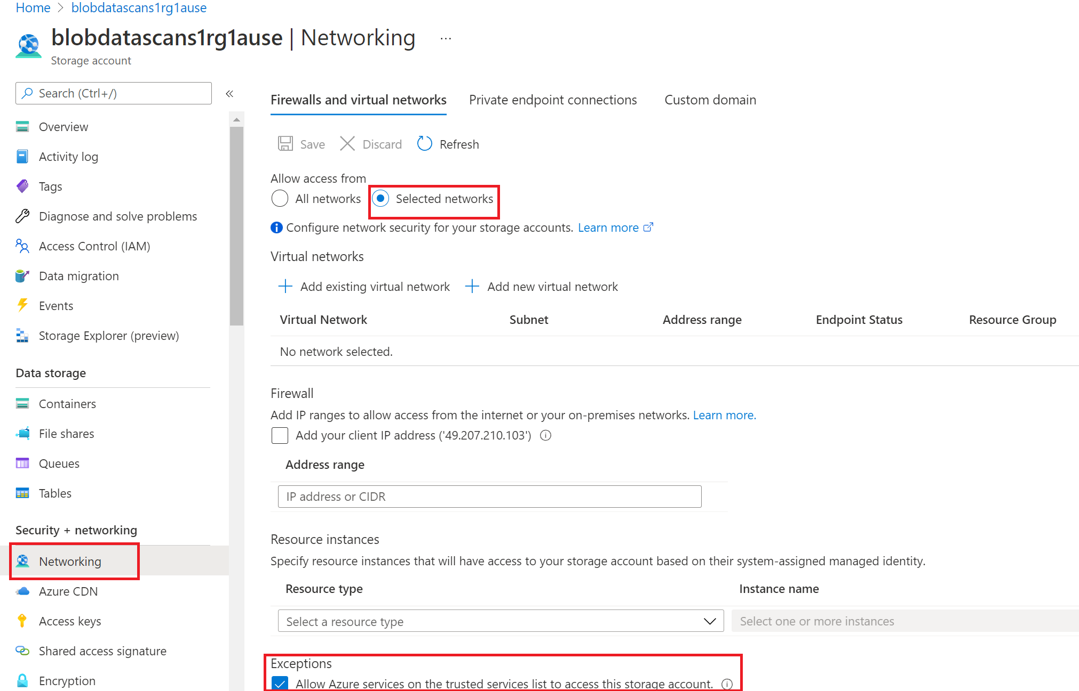
Access from VNet

Slide 48
Data Governance

Slide 49
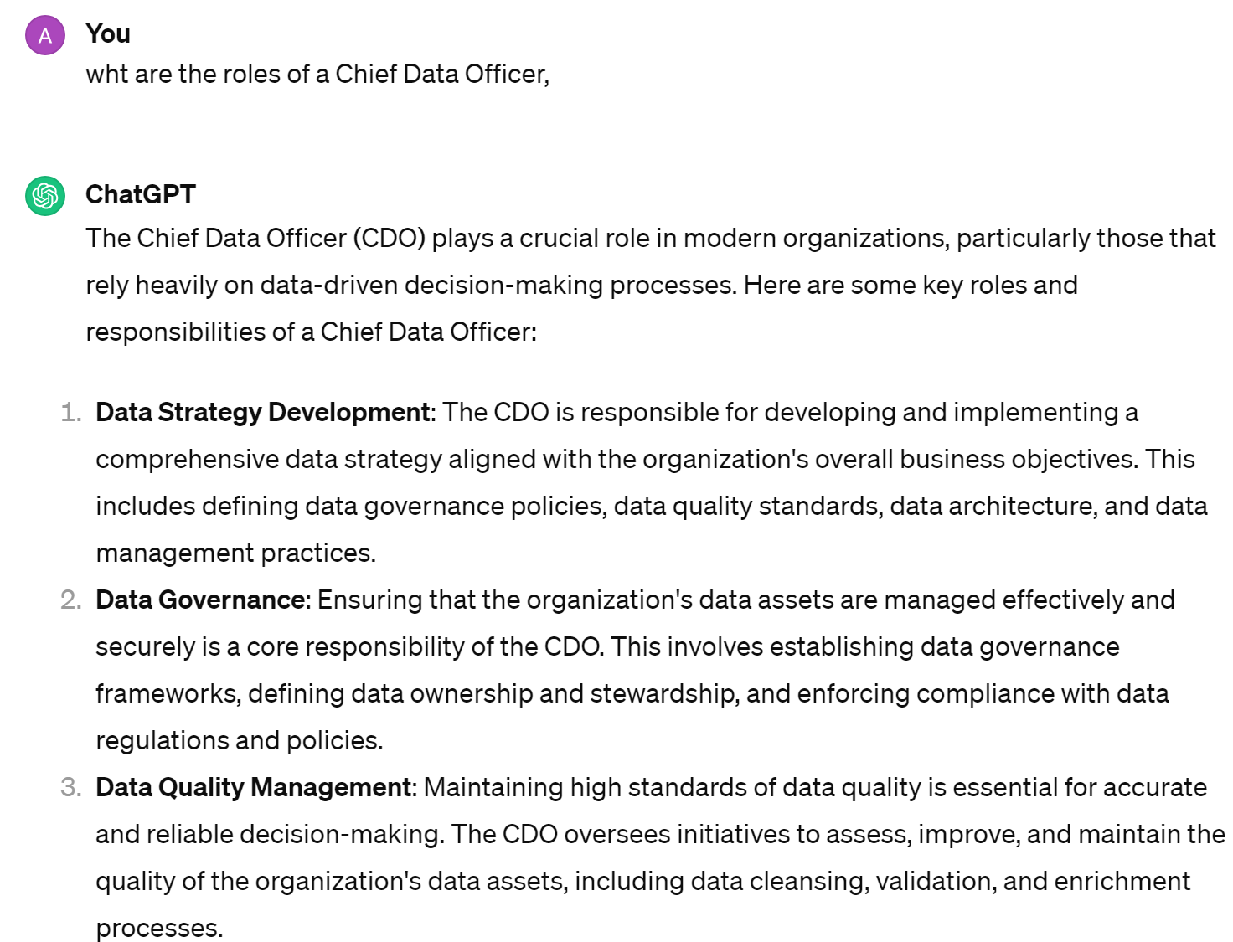
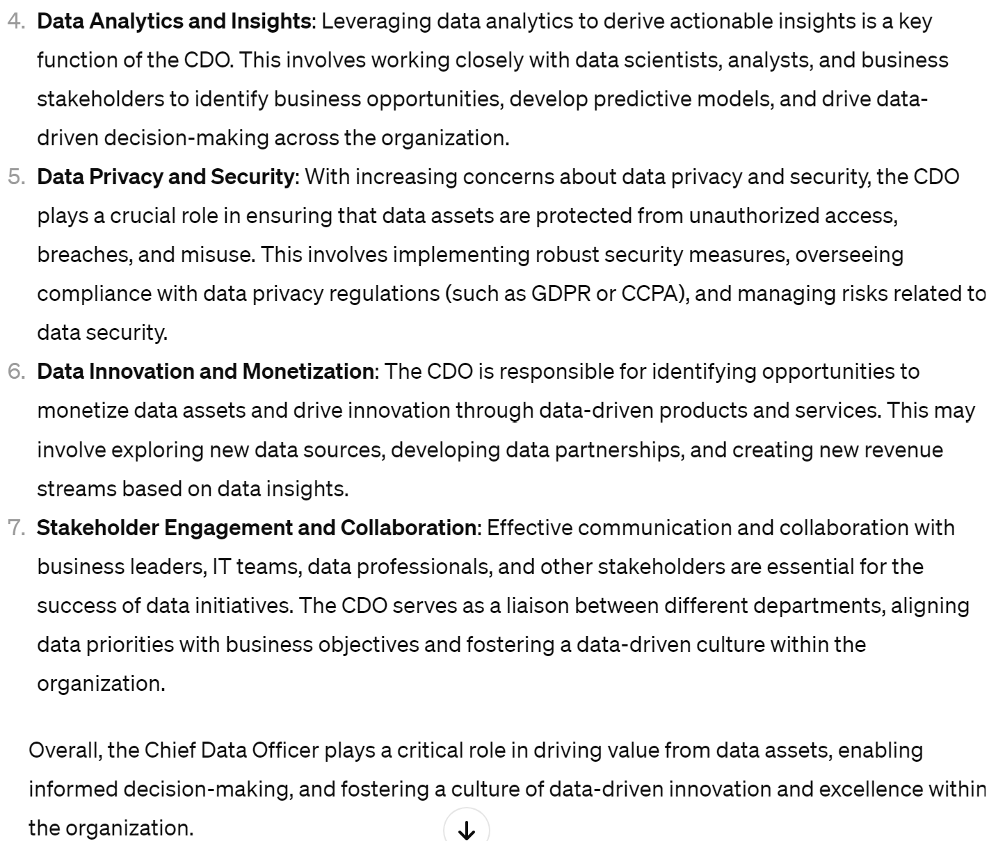
Roles of the CDO (Chief Data Officer) ?

Slide 50
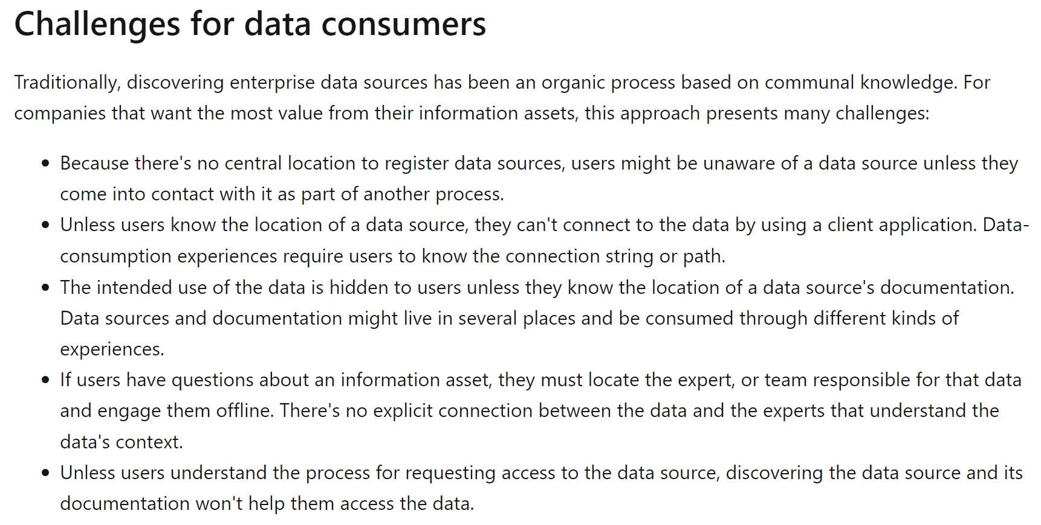
Data Governance Challenges: Data Consumer

Slide 51
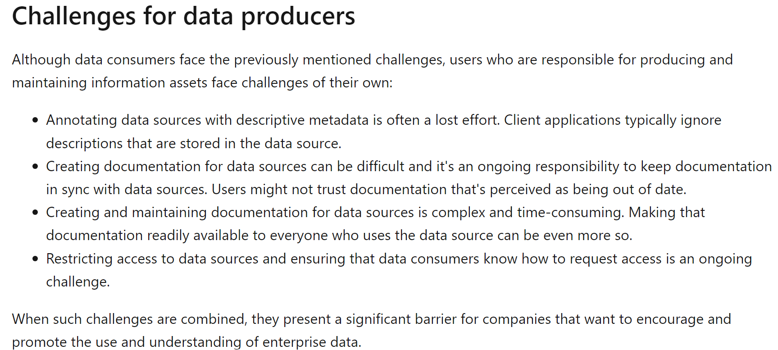
Data Governance Challenges: Data Consumer

Slide 52
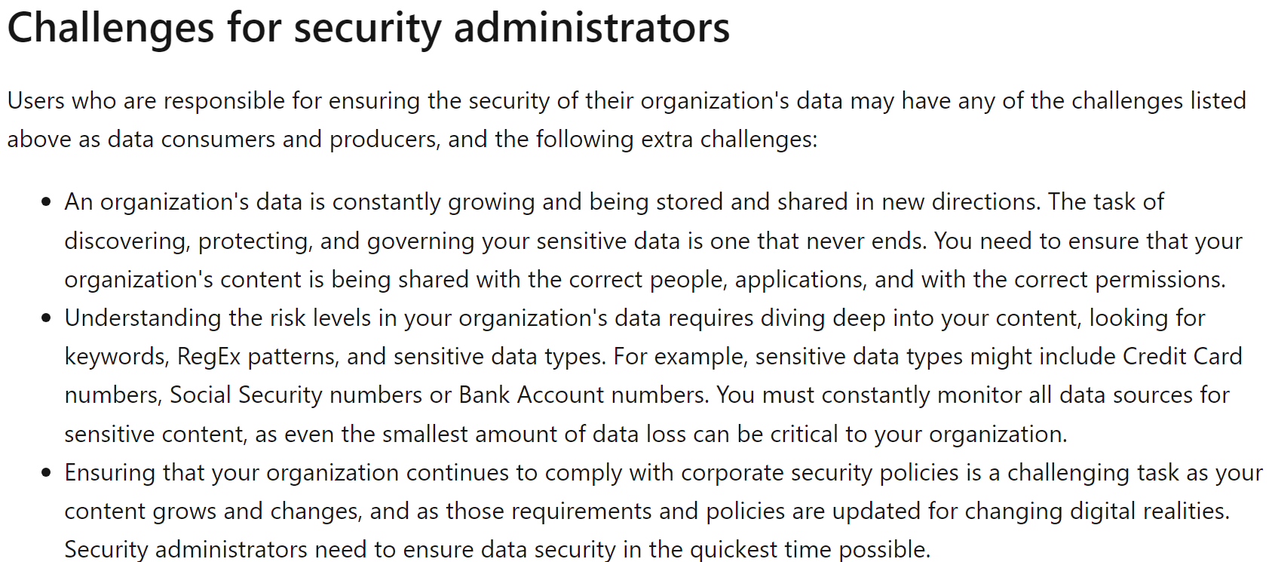
Data Governance Challenges: Data Consumer

Slide 54
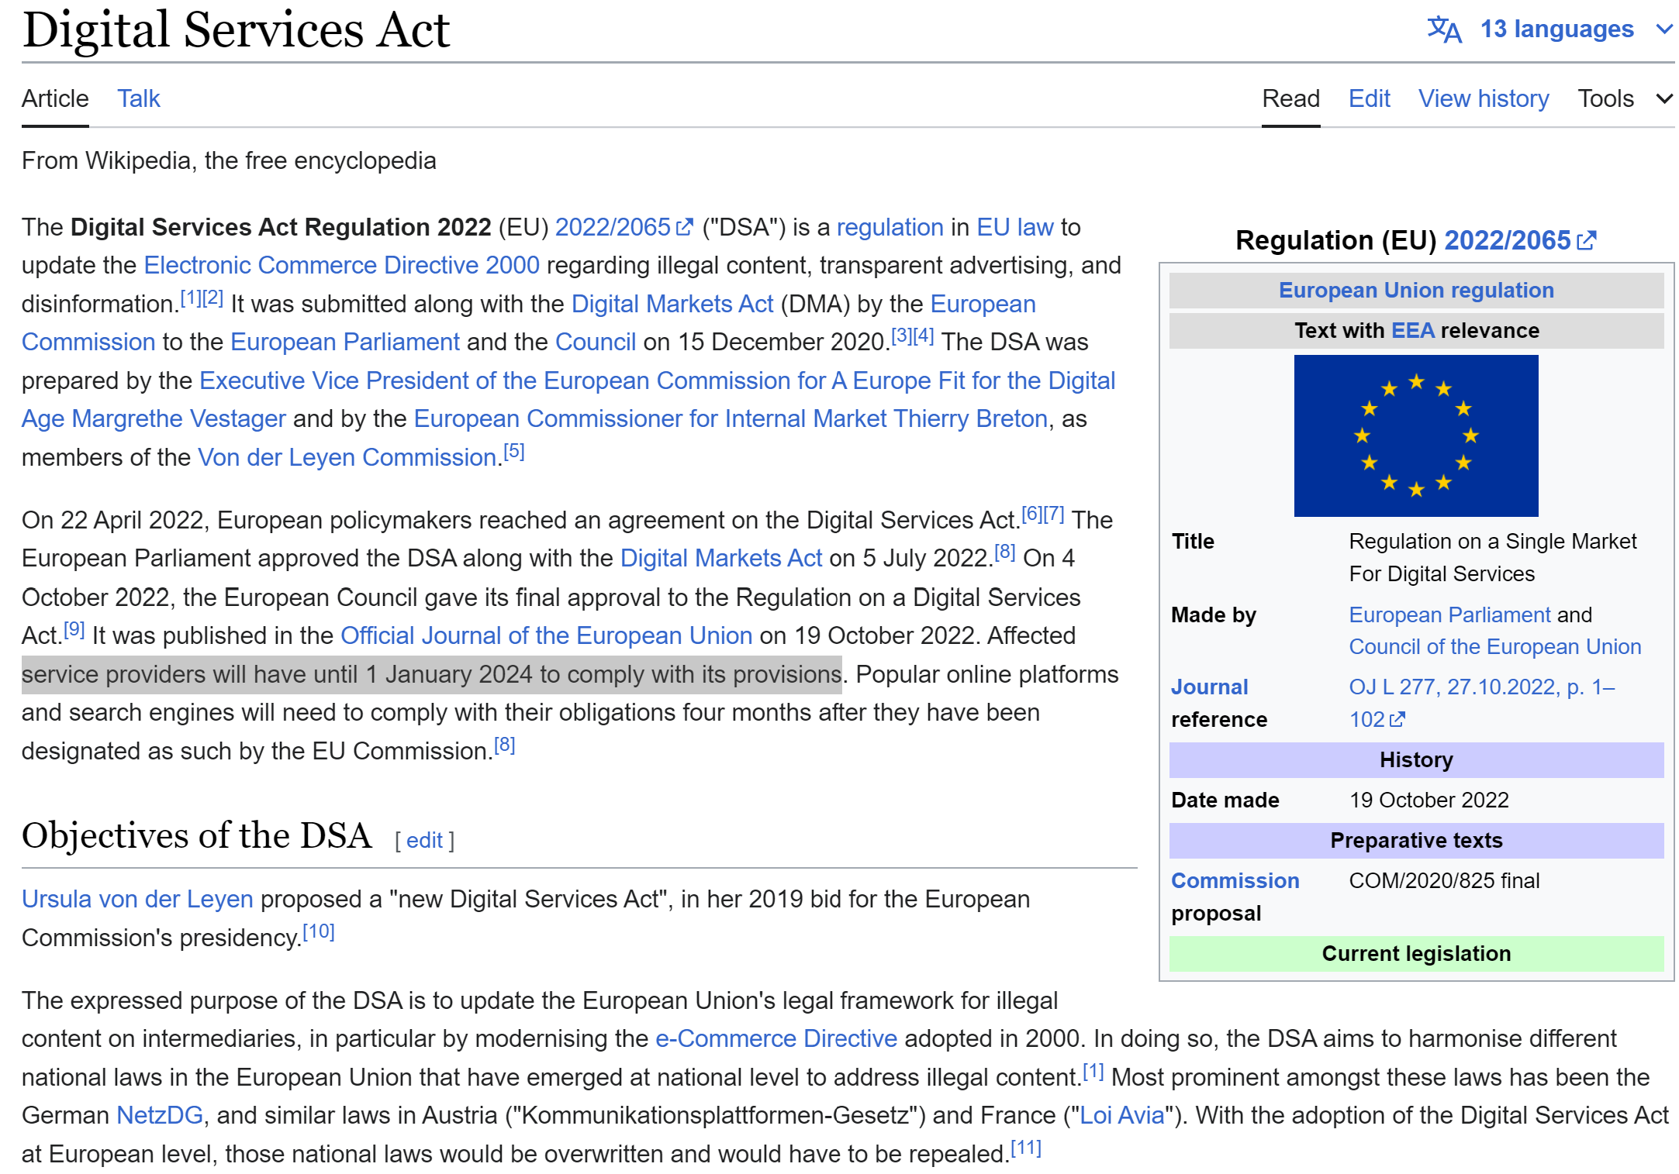
European Digital Service Act

Slide 57
Microsoft PurView

Slide 58
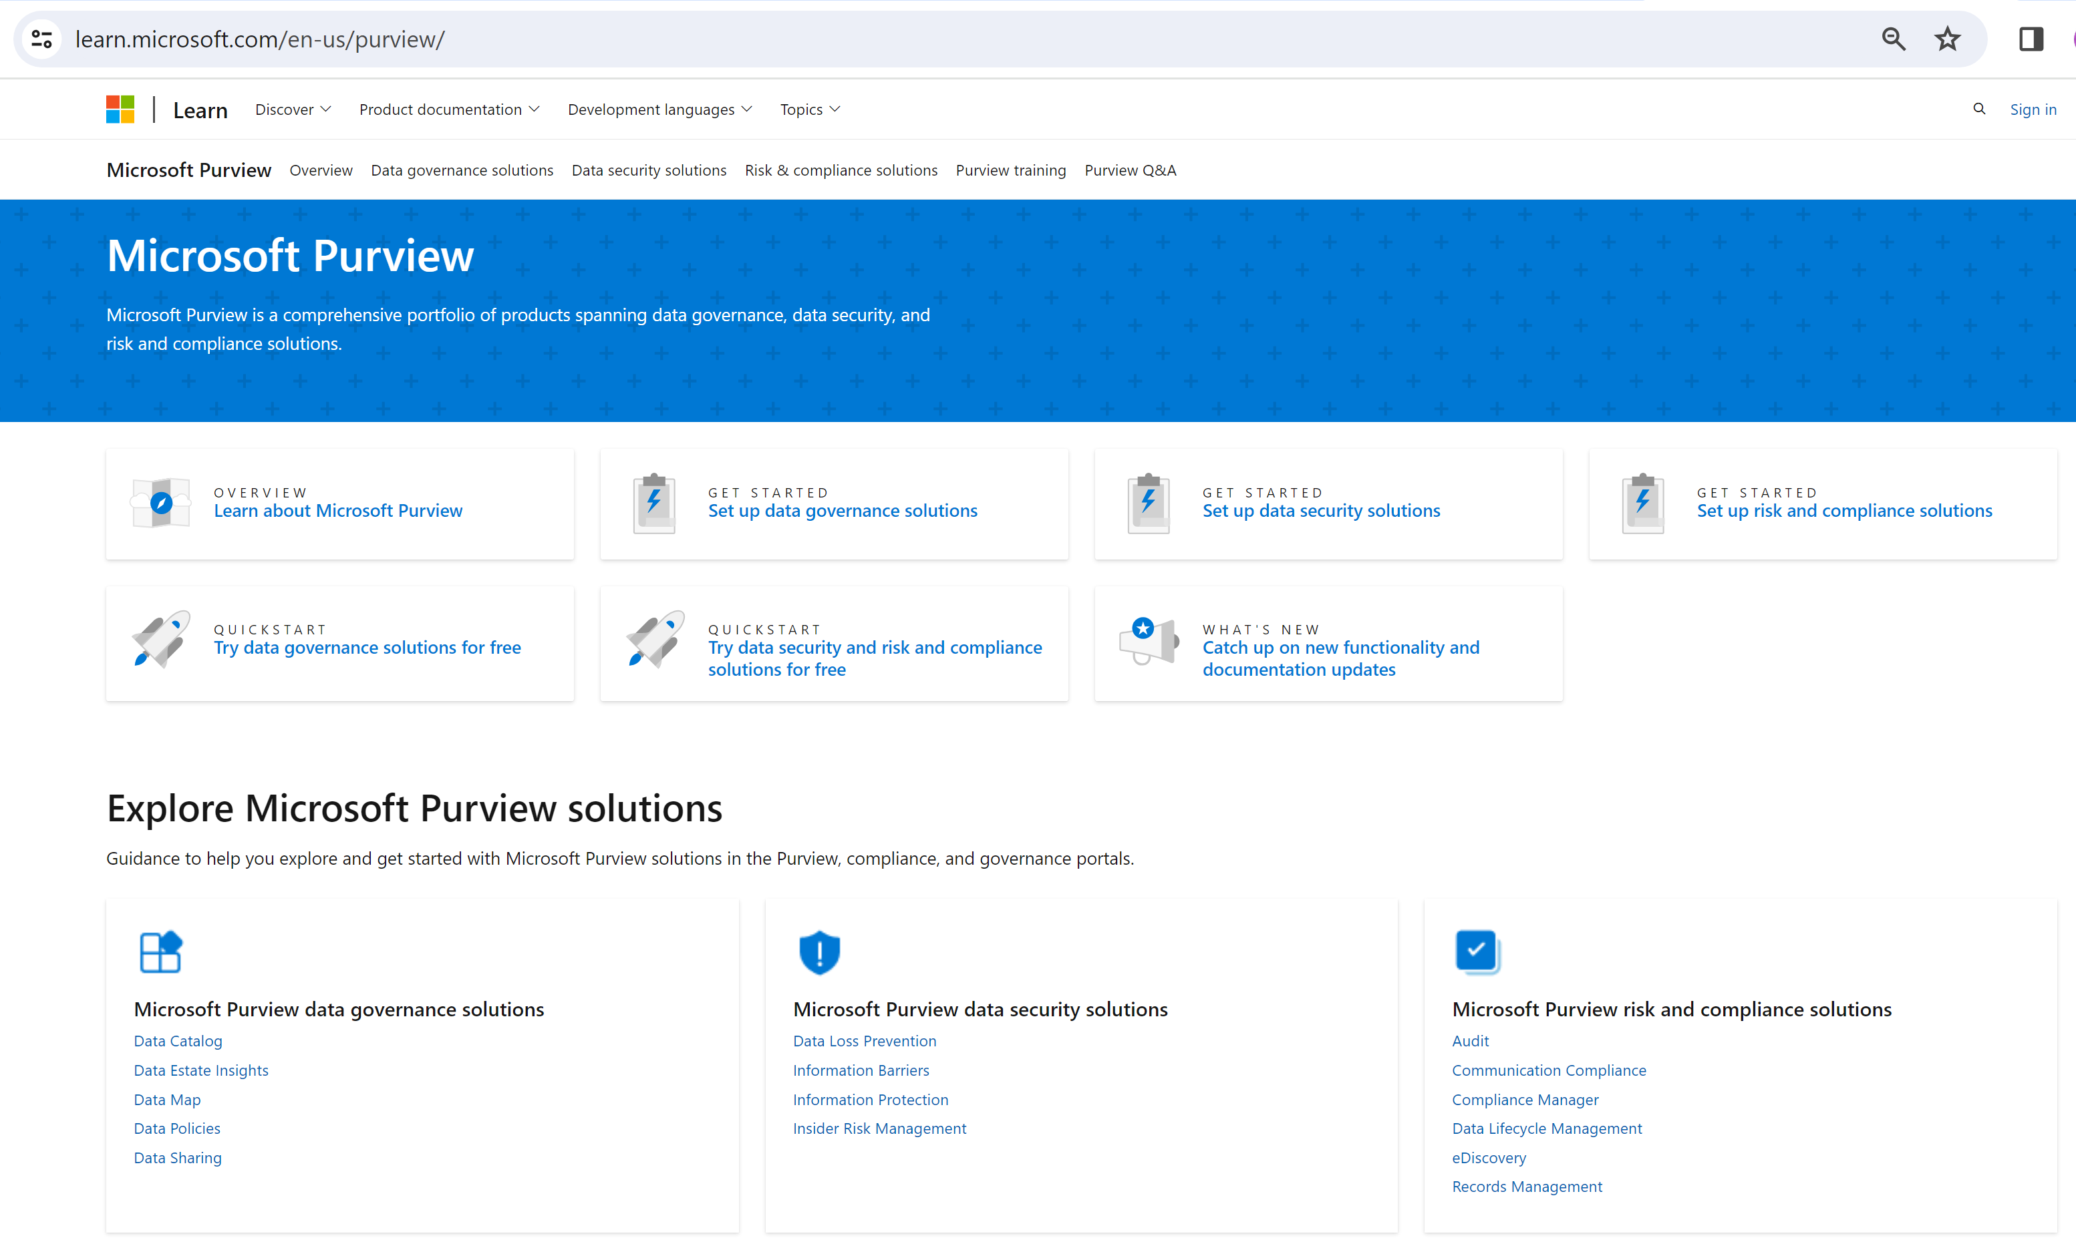
learn.microsoft.com/en-us/purview/

Slide 59
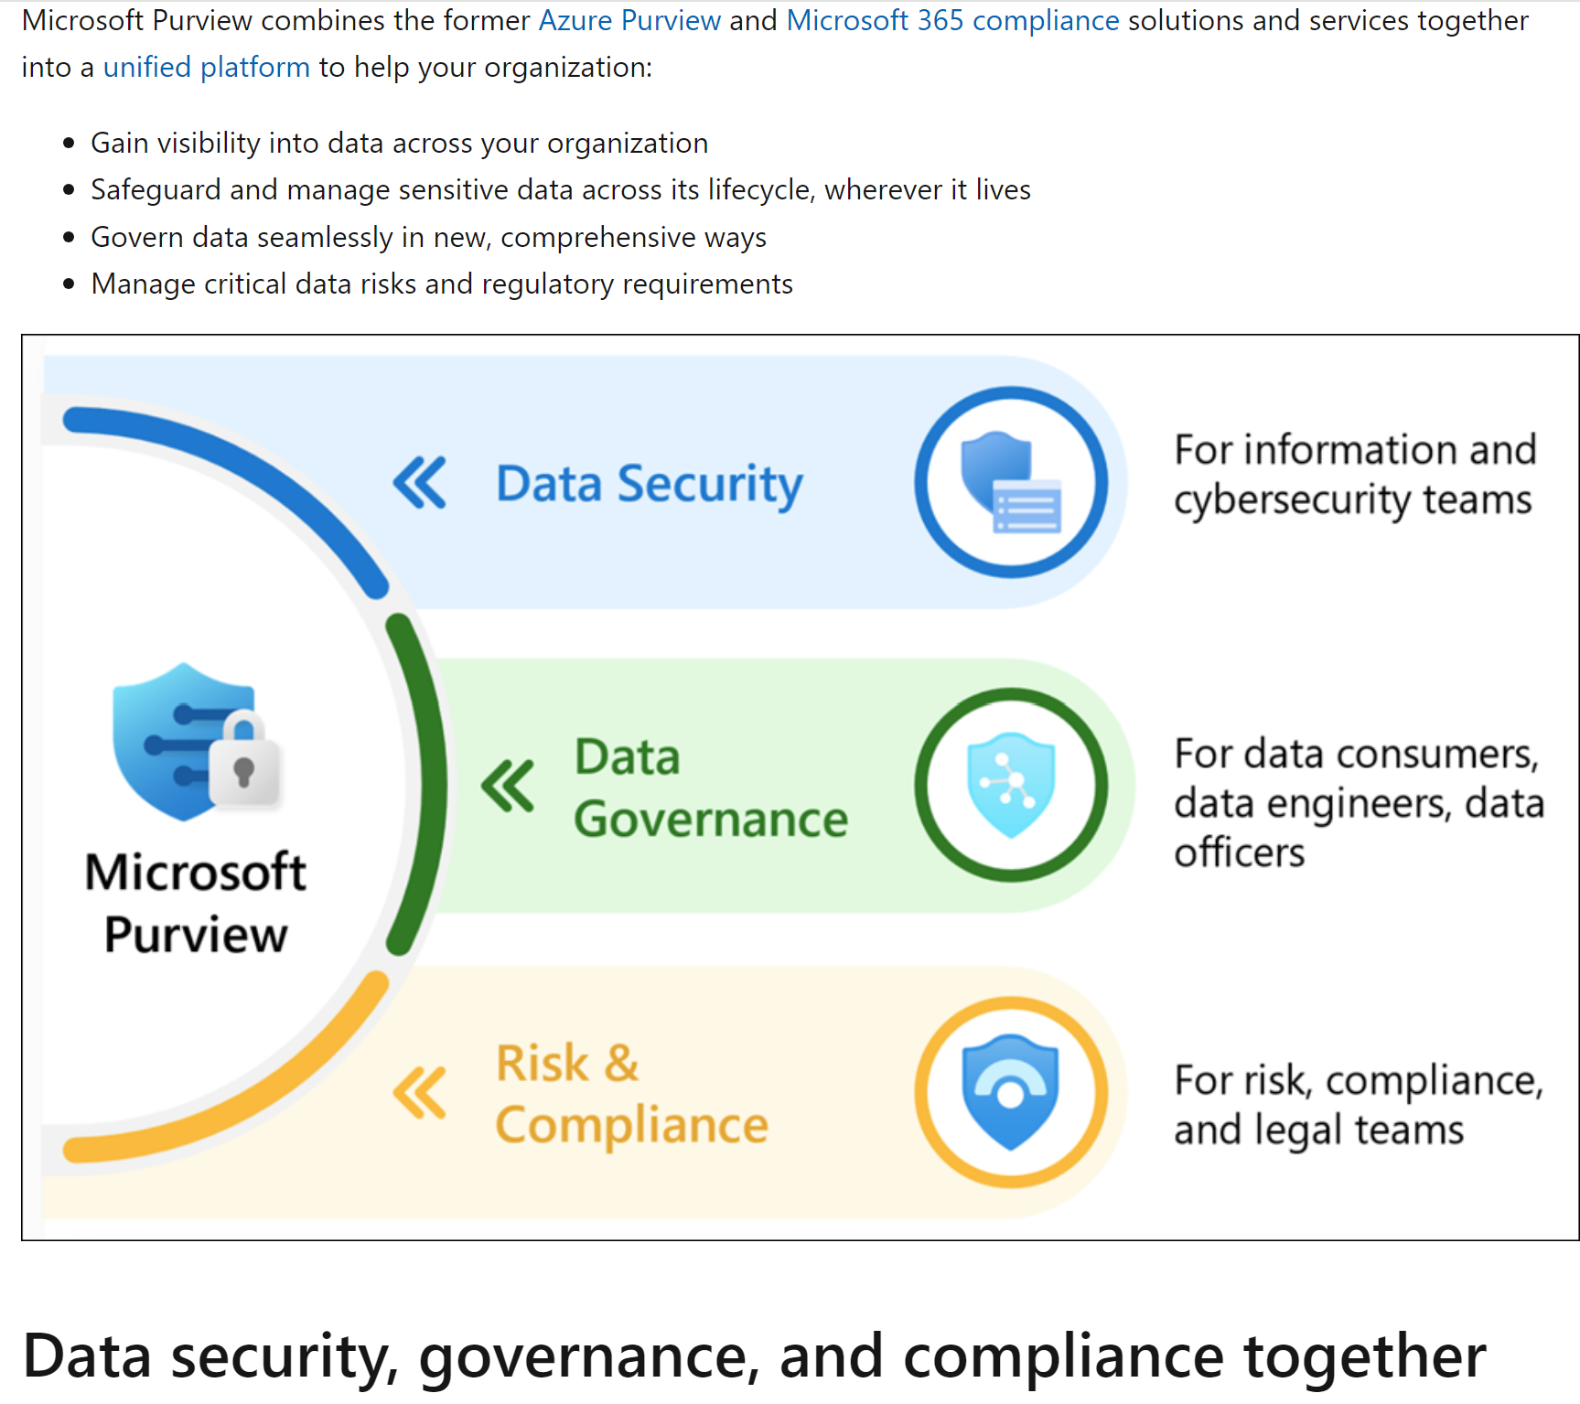
PurView

Slide 60
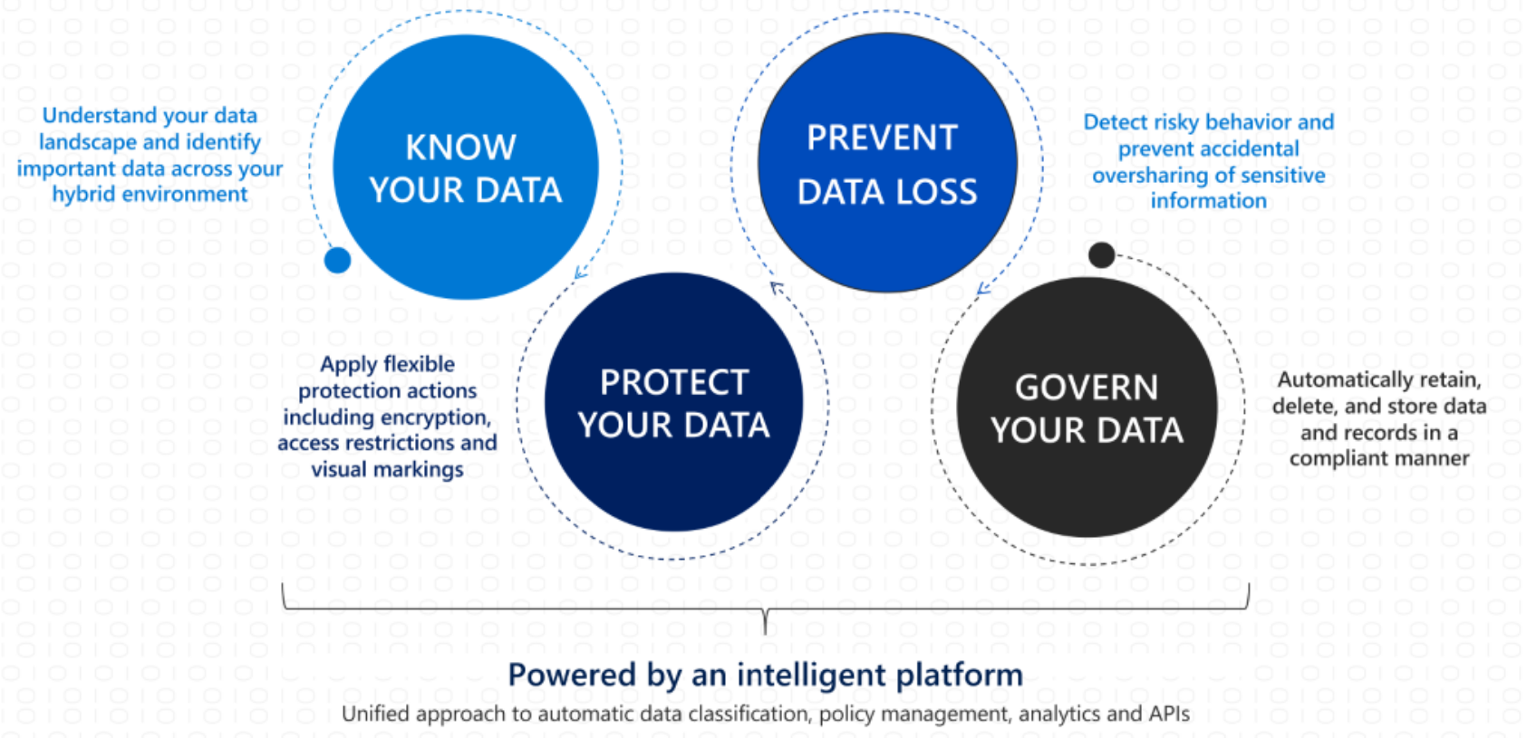
Data: Know -> Protect -> PreventLoss -> Govern

Slide 61
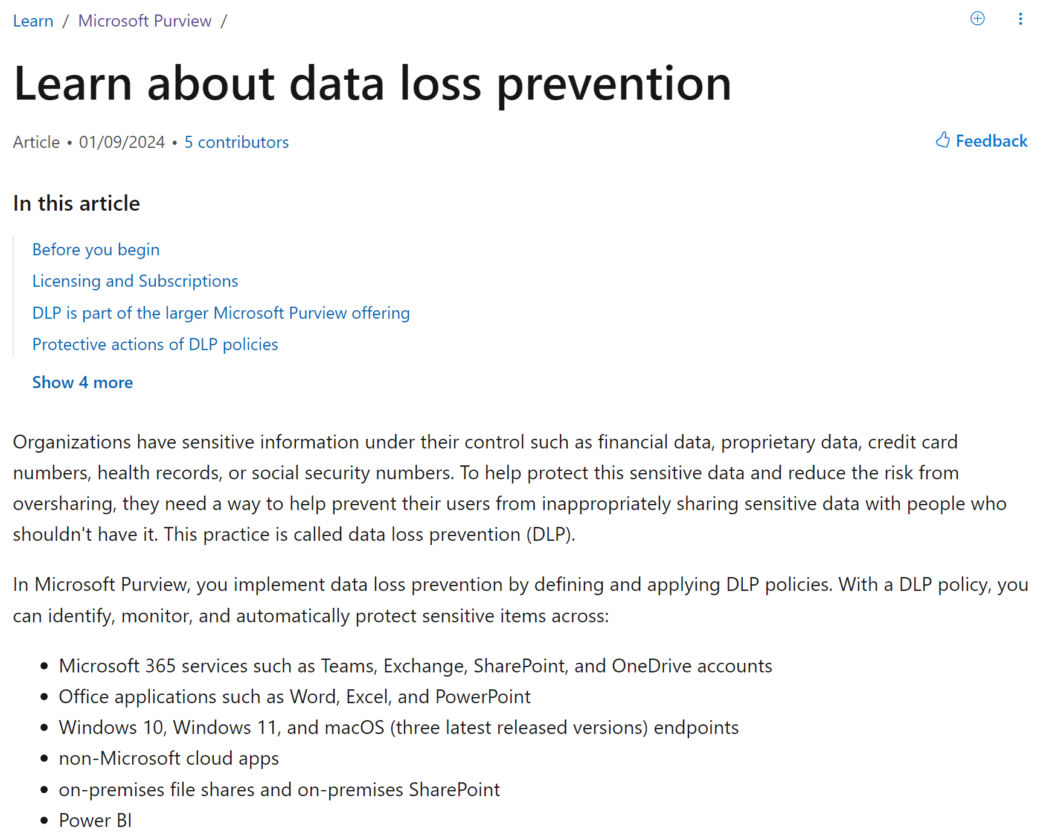
Data Loss Prevention (avoid sharing sensitive data, example: no copy/email)

Slide 62
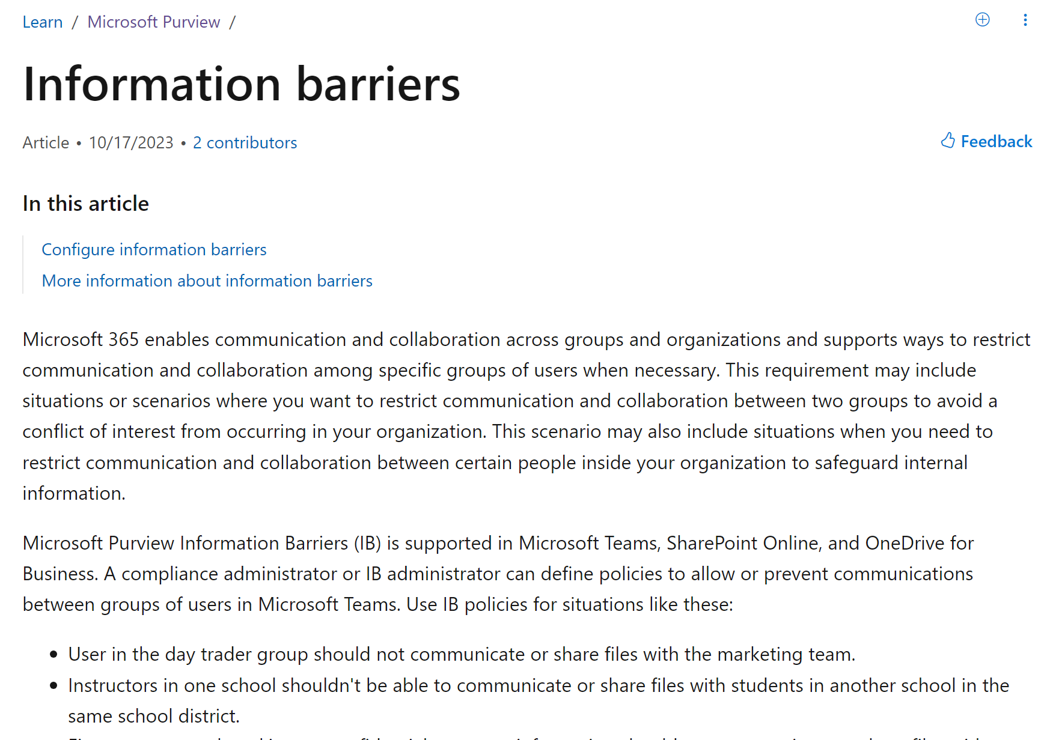
Information Barriers: Chinese Walls

